Slide 1


Lighting for Mental Health Environmental Sustainability Tuesday 10th February 2026
​
Senior Lead, Research, Innovation & Supply Chain
​Greener NHS National Programme
Dr Fanny Burrows
Email: fanny.burrows@nhs.net
Interim Head of Sustainability
Frimley Park, Wexham Park & Heatherwood Hospitals

Slide 2
Greener NHS Delivering a net zero NHS
1

Slide 3

Why is reaching net zero a priority for the NHS?
Since 2020, and the publication of the NHS net zero strategy, the UK has faced some of the warmest years on record.
Rapidly rising global temperatures, are now 1.1°C above pre-industrial levels.
These are projected to exceed 1.5°C, the temperature at which scientists warn there will be irreversible environmental damage, undermining long-term resilience and equity.
Climate change poses a major threat to health
More than 13 million deaths around the world each year are due to avoidable environmental causes.
UK heatwaves on the rise, claiming > 2,500 lives in 2022
Air pollution is the single greatest environmental threat to human health in the UK, accounting for 1 in 20 deaths
Disproportionately impact the most vulnerable and disadvantaged, driving health inequality

Slide 4

The NHS - Our responsibility and opportunity
As the largest employer in the UK, contributing 4.6% of UK emissions, the NHS is part of the challenge and the solution.
Reaching the UK's ambitions under the Paris Climate Change Agreement could see lives saved every year:
5,700 saved from improved air quality
38,000 saved from a more active population
100,000 saved from healthier diets
Notes:
40% of public sector emissions
1m lives per year could be saved by 2050 if world meets Paris goals

Slide 5


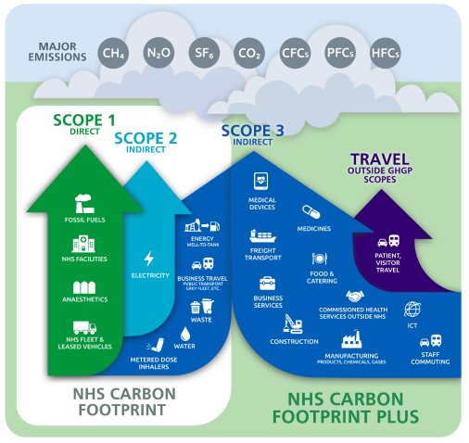
The NHS response - Net zero NHS
Committed to delivering the world’s first net zero health service in its landmark report:
Delivering a net zero NHS:
Net zero for emissions we control directly (NHS Carbon Footprint*) by 2040, ambition to reach an 80% reduction by 2028 to 2032.
Net zero for emissions we can influence (NHS Carbon Footprint Plus**) by 2045, ambition to reach an 80% reduction by 2036 to 2039.
Notes:
6

Slide 6
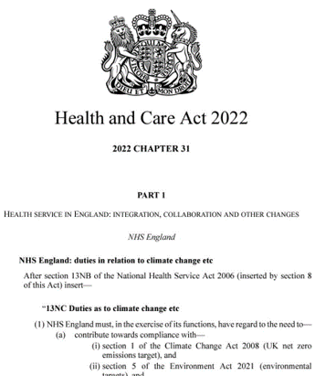
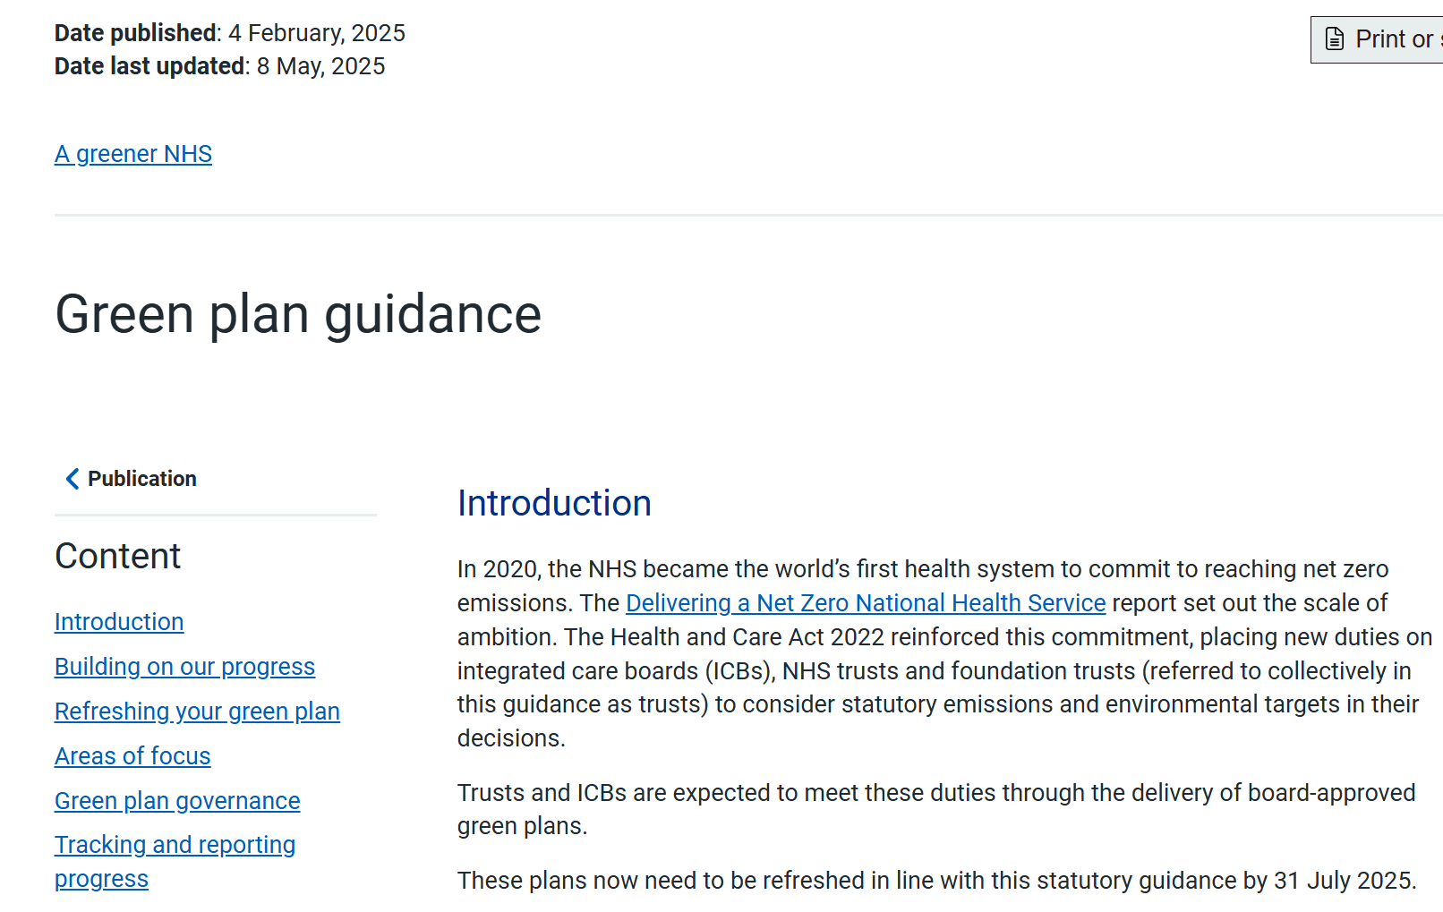

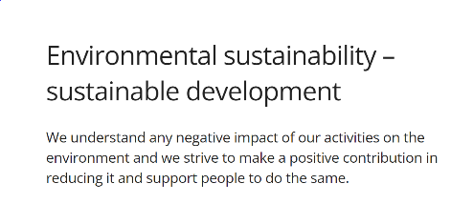
Systems Progress
The NHS Carbon Footprint emissions (scope 1 and 2) have decreased by 14% since the publication of the Delivering a Net Zero NHS strategy, and over 68% since 1990 – Mainly through focusing on the medicines we use, managing our estate effectively and the use of lower carbon travel and transport options within the NHS.
The estimated NHS Carbon Footprint Plus is broadly the same as in 2019 - Increase in emissions following the pandemic and an overall increase in NHS activity. Over this five-year period, the NHS Carbon Footprint Plus has reduced by 15% per real pound of the NHS budget, and by 7% per finished admission episode.
Regulation to include env. sustainability under the “Well-led” key question
First health system to embed Net Zero into legislation
Every NHS Trust & ICB now has a net zero strategy through the provision of Green Plans
Notes:
7

Slide 7
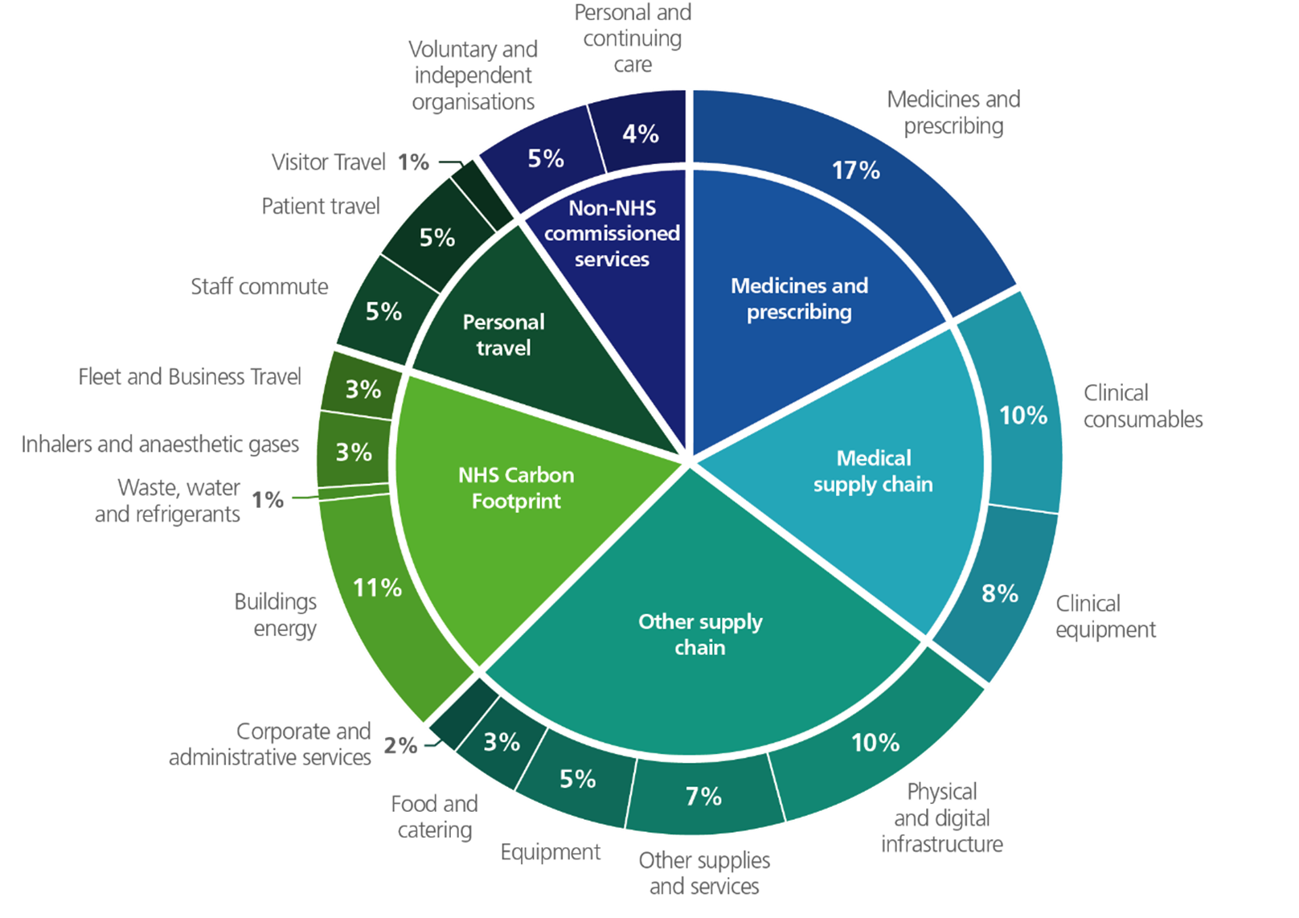
Tackling major areas of carbon emissions

Slide 8












Areas of focus
The Greener NHS programme is structured around key areas for action to reduce emissions. ​
Estates & facilities
Travel & transport
Medicines
Supply chain
Food & nutrition
Research & Innovation
Models
of care
Digital
Workforce engagement
Adaptation
Data, analytics and monitoring

Slide 9
Areas of focus
The Greener NHS programme is structured around key areas for action to reduce emissions. ​
Estates & facilities
Travel & transport
Medicines
Supply chain
Food & nutrition
Research & Innovation
Models
of care
Digital
Workforce engagement
Adaptation
Data, analytics and monitoring

Slide 10
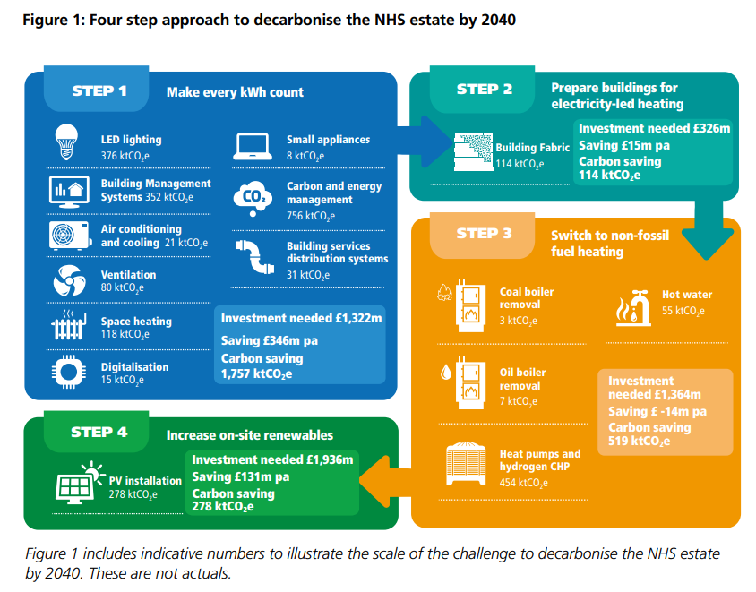

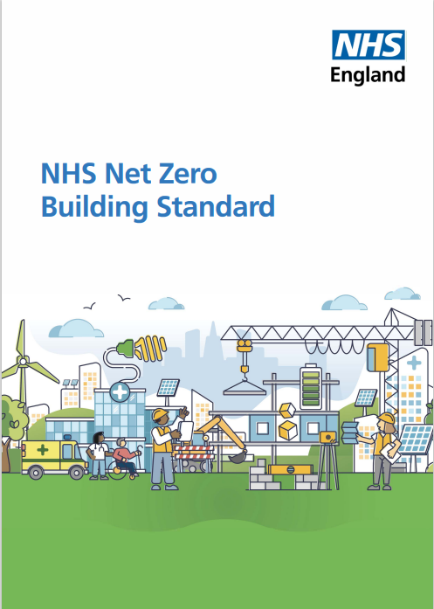
Decarbonising the NHS estate
Notes:
Making every kWh count: Investing in no-regrets energy saving measures
• reducing emissions by minimising heat loss from buildings
• mitigating issues with peaks in demand and reducing overall energy demand
• preparing buildings for low-carbon heat sources • reducing NHS energy bills
2. Preparing buildings for electricity-led heating: Upgrading building fabric
3. Switching to non-fossil fuel heating: Investing in innovative new energy sources 4. Increasing on-site renewables: Investing in on-site generation
. Estates and facilities account for 15% of the NHS carbon footprint. In 2021, the NHS launched the Estates Net Zero Carbon Delivery Plan, which sets out a four-step approach to decarbonising the NHS estate by 2040, with eleven strategic actions for delivering this commitment.
The NHS has recently published its first Net Zero Building Standard. This technical guidance supports the development of sustainable, resilient, and energy efficient buildings that meet the needs of patients now and in the future. Developed together with healthcare, industry, and sustainability partners, the Standard will support the NHS to get ready for and align with UK Government building requirements, as well as meet its commitments to deliver a net zero health service by 2045.

Slide 11
Lighting & Sustainability
2

Slide 12



Lighting & Sustainability
Energy consumption is directly linked with greenhouse gas emissions
Good lighting is critical for better staff and patient experience
SOLUTIONS
Switch to LEDs to reduce energy consumption.
Maximise natural light & daylight harvesting.
Consider lighting occupancy and intelligent sensors (PIR) and daylight controls (daylight linking, light dimming, light levels).
Lighting needs linked to safety and efficiencies.
OPPORTUNITIES
Develop a business case – the figures will add up
Grant funding to fit LED lights and intelligent systems
Consider lighting, and energy consumption in any retrofit project
Design with net zero in mind

Slide 13
Adaptation & Resilience to Climate Change
3

Slide 14

Adaptation & Resilience
Climate change impacts heath, both physical and mental health:
More frequent severe weather events such as flooding, storm and heatwaves – Severe weather events have major impact on health
Heatwaves place additional pressure on NHS infrastructure, ambulance and services. The incidence of overheating at NHS sites in England has almost doubled in the last five years (from 2,980 recorded incidences in 2016-7 to 5,554 in 2021-22).
Climate change will increase the risk of operational disruption in health services from flooding and heatwaves, and increase health conditions.
In July 2022, during a period of extreme heat in London with temperatures reaching 40°C, cooling systems failed at 2 data centres supporting London’s largest NHS trust, causing critical IT outage at Guy's St Thomas' and Evelina London Hospitals – Resulting in:
100 treatment delays
1 case of moderate harm with a patient missing an organ transplant
Service delivery dropped significantly, with referrals at 64%, outpatient appointments at 84%, elective surgeries at 71%and diagnostic tests at 68% of typical July levels.
Emergency IT systems were restored after 5 days, with full recovery extending overal several weeks, incurring £1.4million in additional costs.
Examples​
Total heat-associated mortality of 2,985 in England during the temperatures of summer 2022.​
Interruption to critical services (water, energy, transport, supply chain) may further undermine healthcare delivery.​
​
Notes:
Making every kWh count: Investing in no-regrets energy saving measures
• reducing emissions by minimising heat loss from buildings
• mitigating issues with peaks in demand and reducing overall energy demand
• preparing buildings for low-carbon heat sources • reducing NHS energy bills
2. Preparing buildings for electricity-led heating: Upgrading building fabric
3. Switching to non-fossil fuel heating: Investing in innovative new energy sources 4. Increasing on-site renewables: Investing in on-site generation
. Estates and facilities account for 15% of the NHS carbon footprint. In 2021, the NHS launched the Estates Net Zero Carbon Delivery Plan, which sets out a four-step approach to decarbonising the NHS estate by 2040, with eleven strategic actions for delivering this commitment.
The NHS has recently published its first Net Zero Building Standard. This technical guidance supports the development of sustainable, resilient, and energy efficient buildings that meet the needs of patients now and in the future. Developed together with healthcare, industry, and sustainability partners, the Standard will support the NHS to get ready for and align with UK Government building requirements, as well as meet its commitments to deliver a net zero health service by 2045.

Slide 15
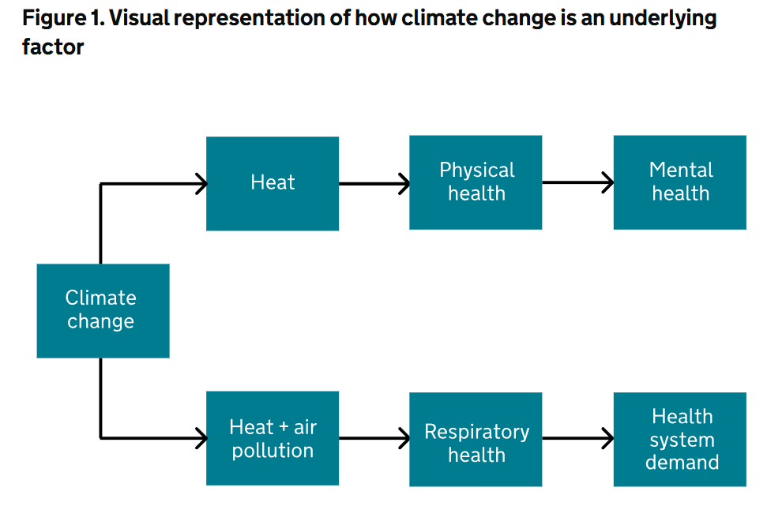
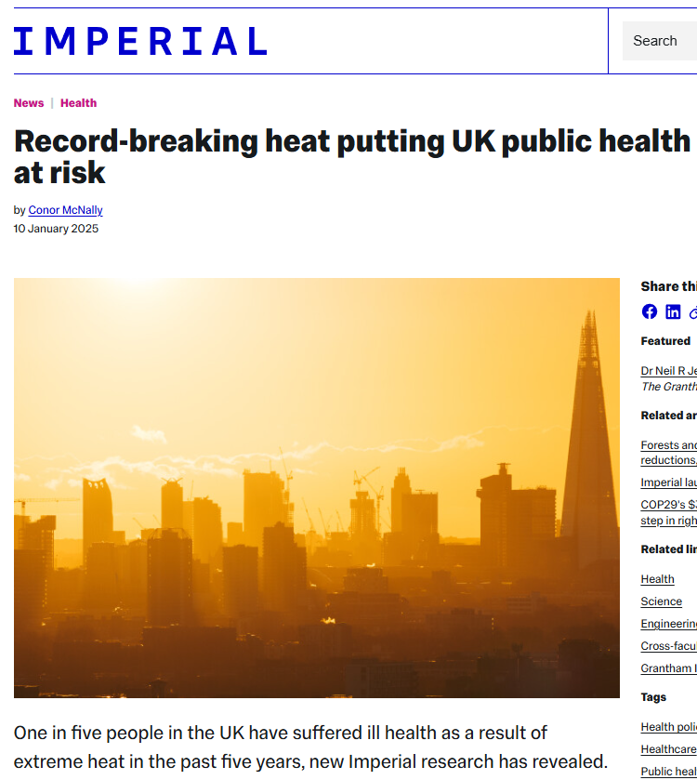
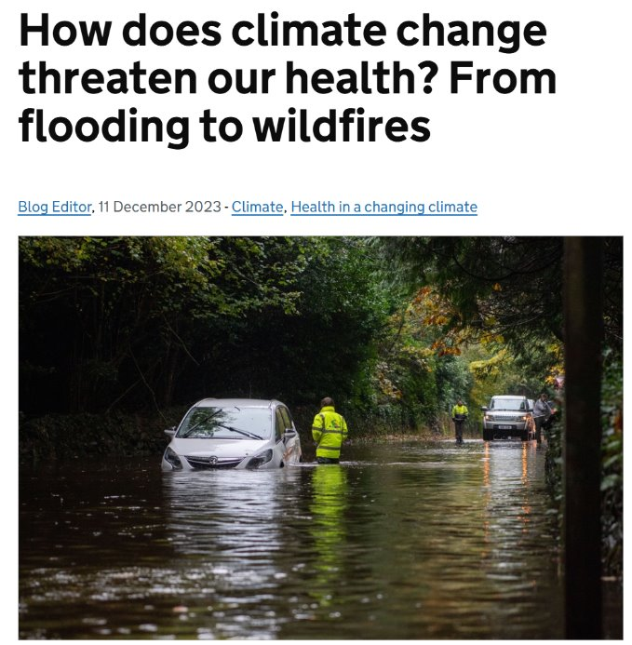
2023 Health Effects of Climate Change (HECC) report – Heat Summary

Slide 16


Adaptation & Resilience
Designing with adaptation and resilience in mind – Our opportunities
Light harvesting – Lights away from windows to maximise daylight use
Interaction with outside / nature maximise natural daylight and improve patient care and recovery
Adapting to the surrounding and environment through sensors and intelligent systems
Preventing over-lighting / light pollution for staff, patients and visitors
Notes:
Making every kWh count: Investing in no-regrets energy saving measures
• reducing emissions by minimising heat loss from buildings
• mitigating issues with peaks in demand and reducing overall energy demand
• preparing buildings for low-carbon heat sources • reducing NHS energy bills
2. Preparing buildings for electricity-led heating: Upgrading building fabric
3. Switching to non-fossil fuel heating: Investing in innovative new energy sources 4. Increasing on-site renewables: Investing in on-site generation
. Estates and facilities account for 15% of the NHS carbon footprint. In 2021, the NHS launched the Estates Net Zero Carbon Delivery Plan, which sets out a four-step approach to decarbonising the NHS estate by 2040, with eleven strategic actions for delivering this commitment.
The NHS has recently published its first Net Zero Building Standard. This technical guidance supports the development of sustainable, resilient, and energy efficient buildings that meet the needs of patients now and in the future. Developed together with healthcare, industry, and sustainability partners, the Standard will support the NHS to get ready for and align with UK Government building requirements, as well as meet its commitments to deliver a net zero health service by 2045.

Slide 17
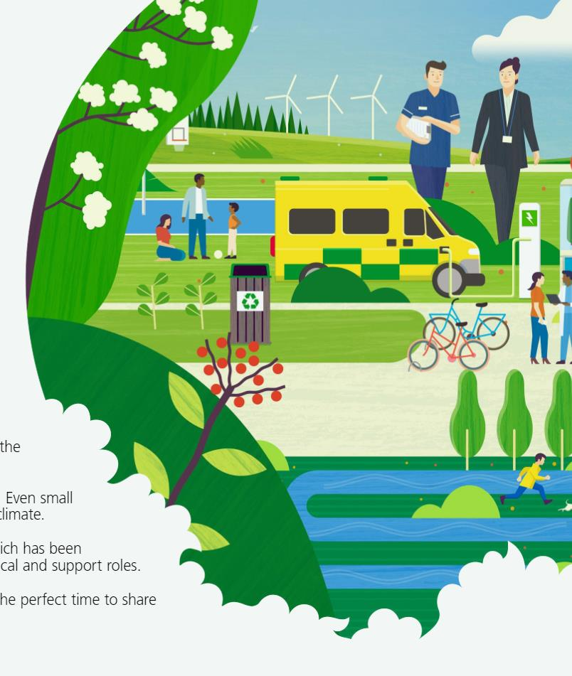

Thank you!
Contact: fanny.burrows@nhs.net
Find out more:
Visit www.england.nhs.uk/greenernhs​
Sign up to our newsletter – www.england.nhs.uk/email-bulletins/greener-nhs​
Follow us on social media - @GreenerNHS​
Future NHS workspace (NHS staff only): https://future.nhs.uk/sustainabilitynetwork
FutureNHS Knowledge Hub (NHS staff only): Greener NHS Knowledge Hub - FutureNHS Collaboration Platform

