Slide 1
Lighting in Mental Health
Supporting Wellbeing with Circadian Rhythms
Lee McCarthy
Director of Lighting at Light Years Ahead

Slide 2
What keeps you awake at night?
Is it blue light?
Is it worrying about lighting your facility?
What barriers do you face in your own facilities when considering lighting upgrades? Is it budget, risk, resistance to change, or something else?

Slide 3
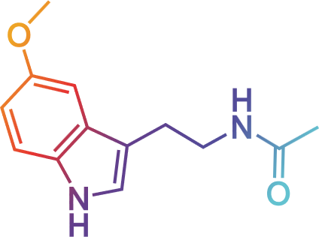
Why Lighting Matters in Mental Healthcare
Lighting influences more than just vision. Light helps regulates our sleep-wake cycles through a hormone called melatonin.
Light can regulate alertness & mood, cognitive performance and melatonin production.
Align lighting with natural circadian rhythms to support wellbeing.

Slide 4




World-leading technology, promoting wellbeing
Increased alertness
Improved mood
Higher quality sleep

Slide 5

Melagen in Practice
Mimics natural daylight. Bright, blue-enriched light in the morning. Warm, blue-depleted light in the evening.
The measure of blue in a light source is the driving factor in suppressing or allowing the release of melatonin from the pineal gland. Harmonises with staff shifts and resident routines. Plays a crucial role in well-being, staff efficiency, and overall safety.
Benefits:
Improved sleep patterns (quality and length)
Alertness during the day
Increased productivity during the day

Slide 6
Melagen Cycle
Workplace / Wake Up
Daytime
Melagen blue-enriched for alertness
Evening Transition
3-hours before sleep
Transitions gradually from blue-enriched to blue-depleted light
Pre-Sleep
2-hours before sleep
Blue-depleted light, ready for deeper sleep
A typical Melagen installation would phase from blue-enriched during the day, gradually transitioning to blue-depleted light.
This maximises alertness during the day, while easing individuals into the evening ready for a better quality sleep.

Slide 7





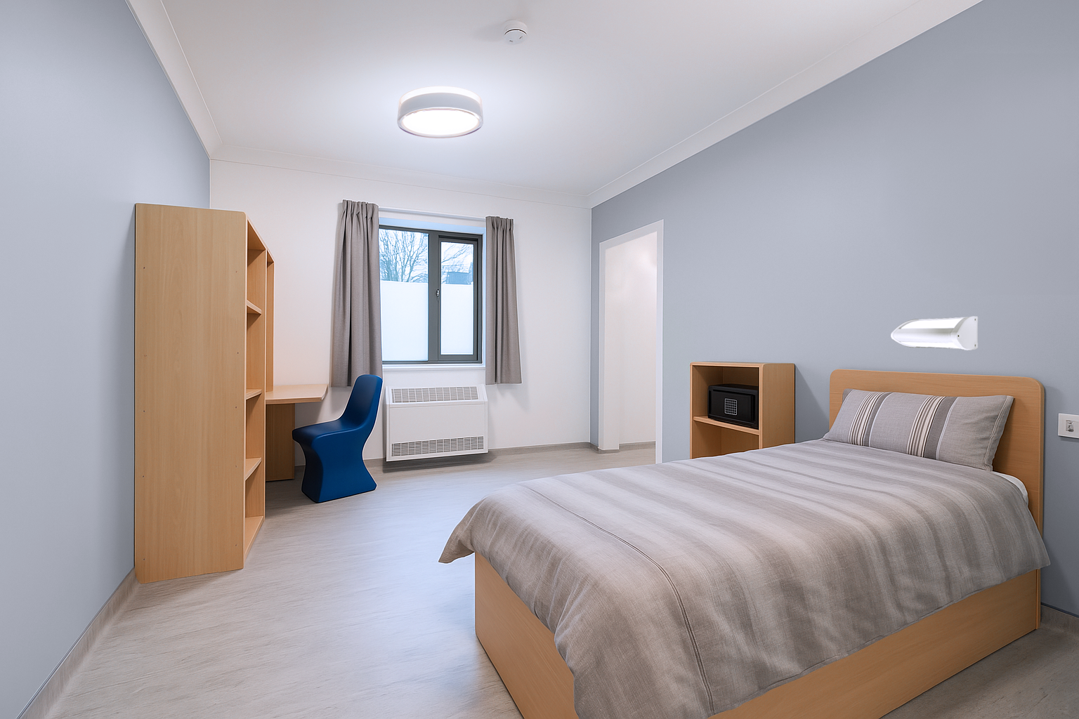
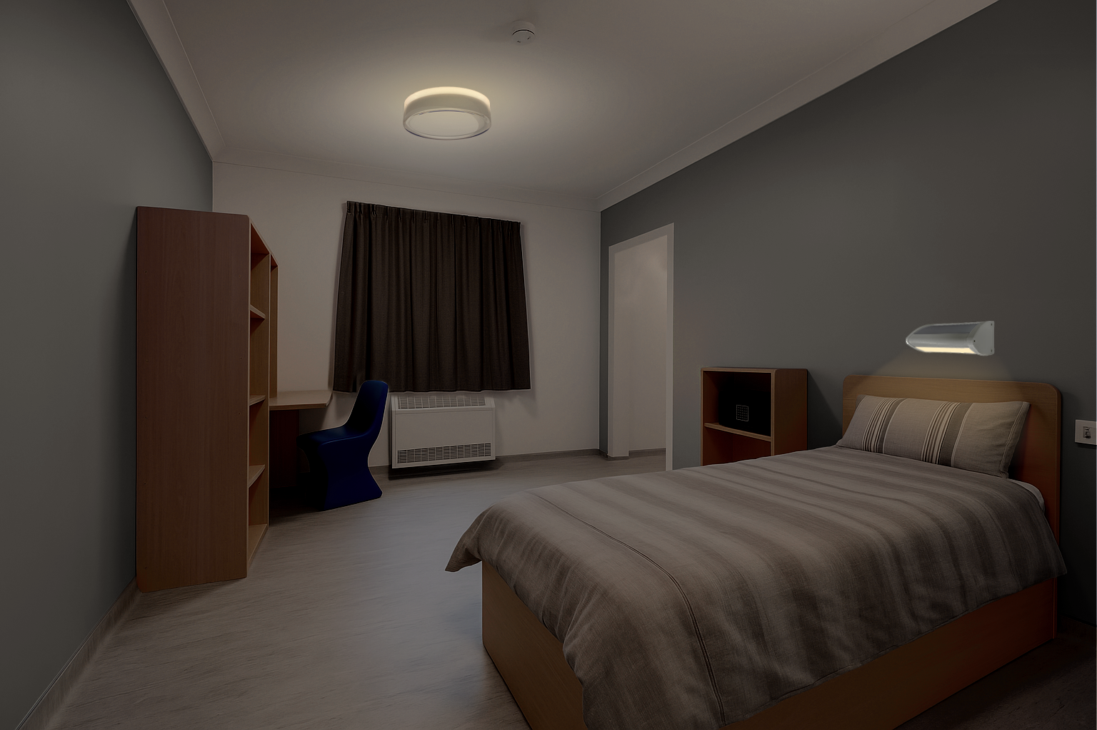
Human-Centric Lighting
Primary Focus
The control and/or regulation of colour temperature (purely aesthetic)
Mimics the changing colour temperature of daylight. (Non-visible blue light
is still present)
Better sleep, calmer days, brighter care
Primary Focus
The control and regulation of blue light frequencies (480-490nm) while maintaining high CRI (>90)
As well as mimicking daylight colour change, also mimics the brain’s ‘master clock’ circadian response to:
MelaGen is an innovative lighting solution, designed to support circadian health through targeted wavelength control. Unlike generic tunable lighting, MelaGen focuses on biologically-effective spectral output, enriching or reducing specific wavelengths to align with the body’s natural rhythms.
An optional extra within select luminaires, such as the Lucca, Como and Resistalux
Limited influence on
Wakefulness during
ranges, the MelaGen internal electronics work with widely used control systems like DALI, MyMesh or with Casambi controls. The result is a discreet but highly effective way to support healthier sleep cycles and calmer daytime behaviour in mental healthcare settings.
✘ melatonin levels
✔ daytime (high blue light)
✘ Limited impact upon
✔ Sleep during the evening
alertness and sleep
(depleted blue light)
Lucca 350 -
Showing 4200K Blue-enriched, combined direct & indirect mode
Lucca 350 -
Showing 2200K Blue-depleted, indirect mode only
Day
Blue-enriched light promotes
alertness and wakefulness
Night
Blue-depleted light promotes
better quality sleep

Slide 9
Notes:
Lighting affects more than just what we see. In mental and secure healthcare, where well-being and safety must be balanced, it’s also a powerful tool for healing, sleep, cognition, and behavioural stability. Did you know the right lighting can reduce falls by over 40% in aged care facilities? Or that it can improve mood and reduce aggression in secure mental health environments?
The most recent Alertness CRC and Monash University research shows that blue light can significantly suppress melatonin. Exposure to blue light can in some individuals, cause the rise of melatonin to occur up to 2 hours later and reduce the amount of slow-wave activity during sleep by 20%.
Light exposure can be linked to:
Mood disorders (depression, anxiety)
Sleep quality and emotional regulation
Agitation, disorientation, and safety at night

Slide 10
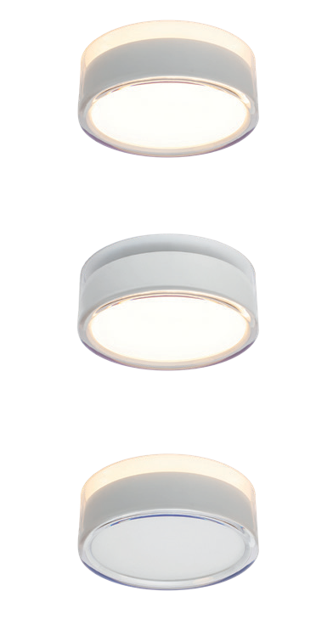

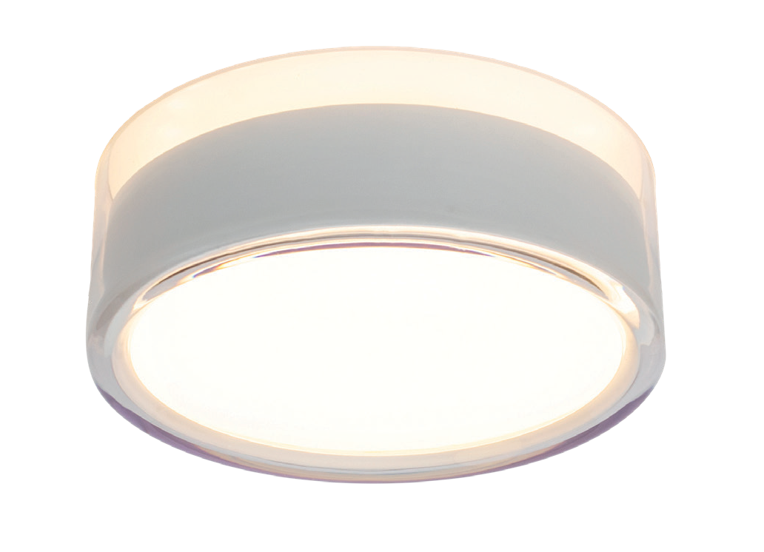

Slide 11
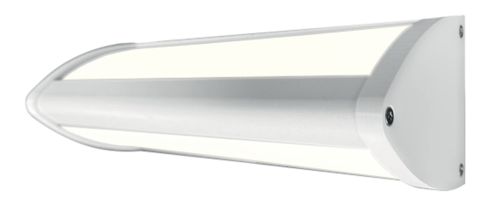
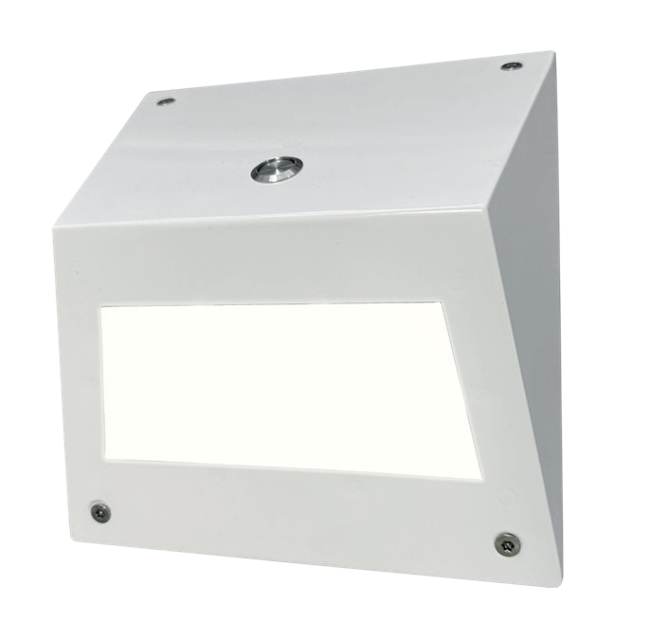
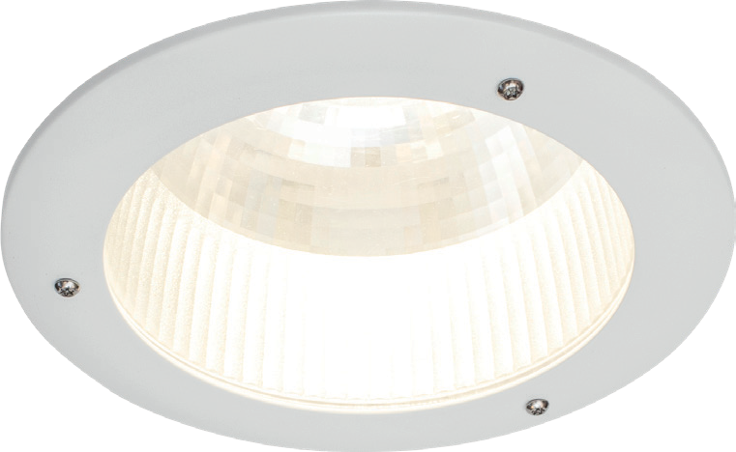

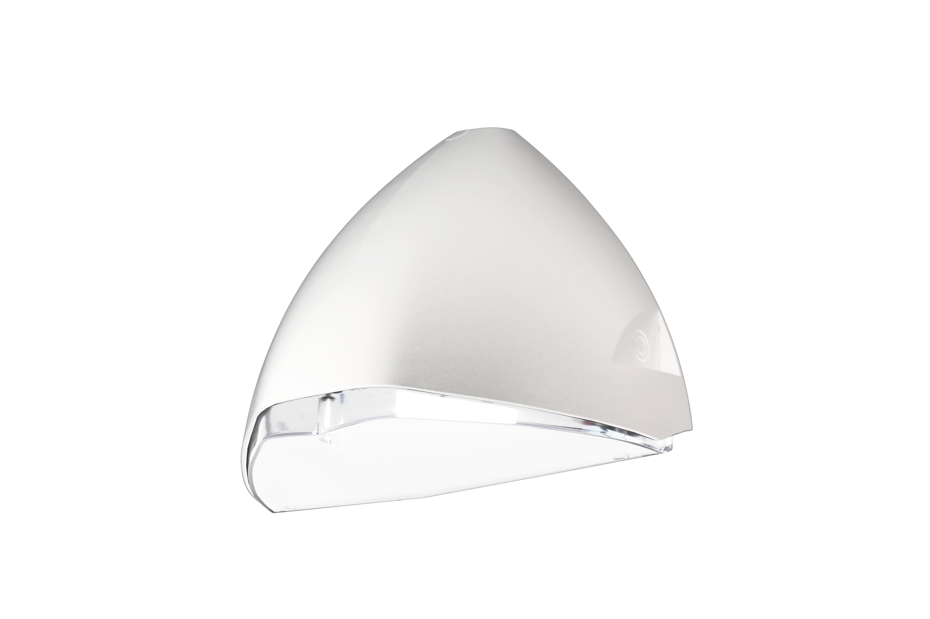
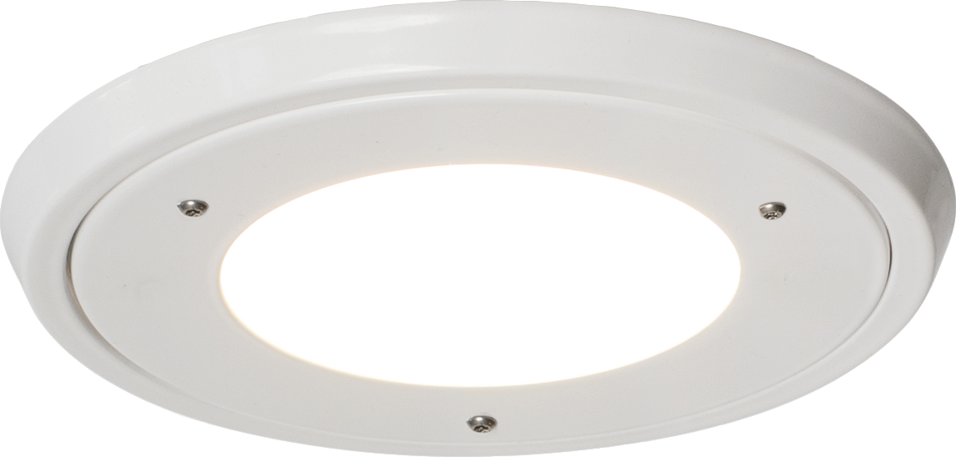
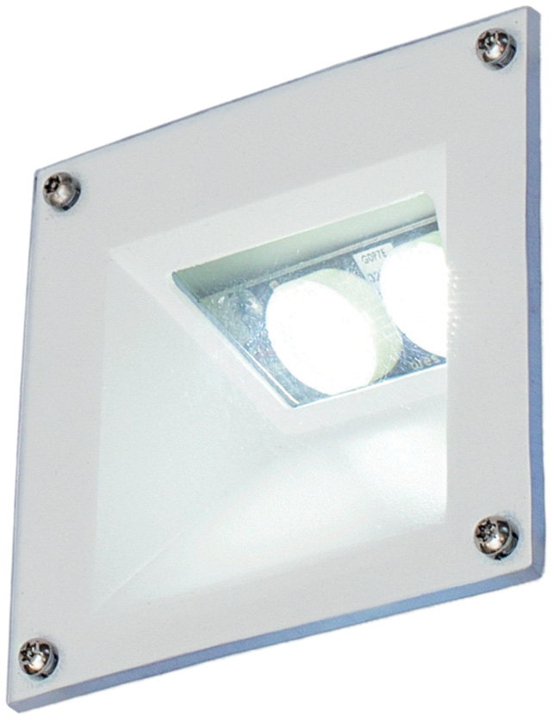

Slide 12











Colours and Customisation
As part of our commitment to patient-centred design, we offer a selection of durable, high-
quality paint options that help our luminaires fit naturally into a variety of care environments.
RAL9003
White (Standard interior)
RAL9002
Grey White
RAL7035
Light Grey
RAL7016
Anthracite
RAL9005
Black (Standard exterior)
Our finish options include both standard and soft, pastel tones chosen to promote a sense of calm, reduce visual stress, and help define spaces without being overwhelming. These colours have been selected to support safe, non-institutional design in mental health spaces.
Additional RAL colours may be available on request to suit project branding, ward differentiation, or way-finding strategies.
RAL6034
Pastel Turquoise
RAL6019
Pastel Green
RAL5024
Pastel Blue
RAL4009
Pastel Violet
RAL1034
Pastel Yellow
Please note: Colours shown in this brochure are for guidance only and may not accurately represent the final product due to variations in print processes and materials.
Readalux Bulkhead shown, for further details scan here

Slide 13




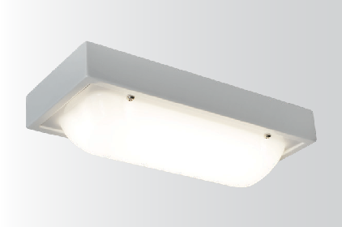
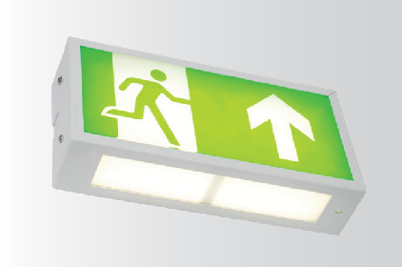
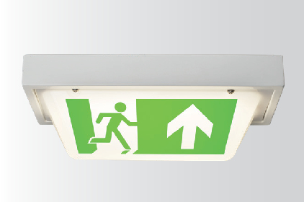
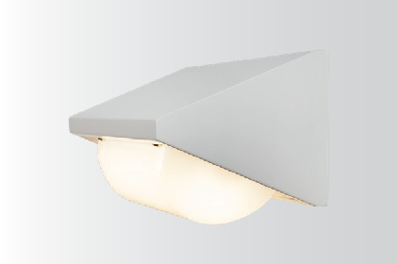


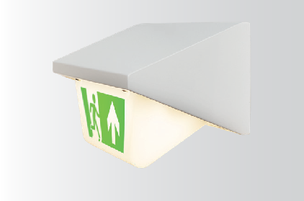

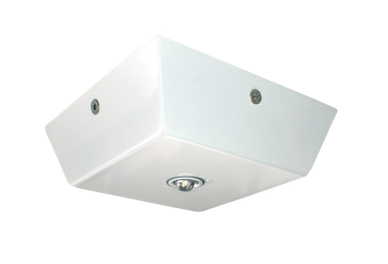
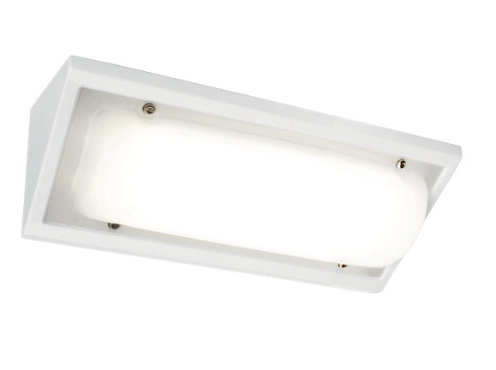
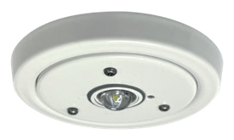
Emergency Lighting
Effective way-finding even with power loss
Emergency lighting in mental healthcare environments must ensure safe movement, staff response, and clinical care during power loss, while maintaining a calming and unobtrusive presence. Although regulations typically require 1 lux along escape routes, higher levels are often specified in consultation with estates and clinical teams.
High-risk areas such as seclusion rooms, high-observation bedrooms and treatment spaces may require 10 to 15 lux vertically to support supervision, rapid intervention and visibility for security systems.
All of our luminaires are available with integral maintained emergency variants, with high-output options offered where increased levels are needed. This minimises the need for additional fittings. We also offer non-maintained and slave options for use with central battery systems, ensuring flexible emergency coverage across all areas.
W375 x D160 x H100mm
Guardalux Bulkhead
IP54, IK15 (125J)
W360 x D80 x H180mm
Guardalux Exit Box
IP54, IK11 (50J)
W375 x D160 x H145mm
Guardalux Double-Sided Exit Sign
IP54, IK14 (100J)
W375 x D160 x H160mm
Guardalux Over-Door
IP54, IK15 (125J)
L160 x W160 x H50mm
⌀100 x H10mm (50mm cutout)
W375 x D160 x H200mm
Guardalux Over-Door Exit Sign
IP54, IK14 (100J)
W375 x W127 x H127mm
Guardalux Anti-Ligature Surface Emergency Light IP54, IK11 (50J)
Guardalux Anti-Ligature Recessed Emergency Light IP54, IK11 (50J)
Guardalux Cornice
IP54, IK15 (125J)

Slide 14

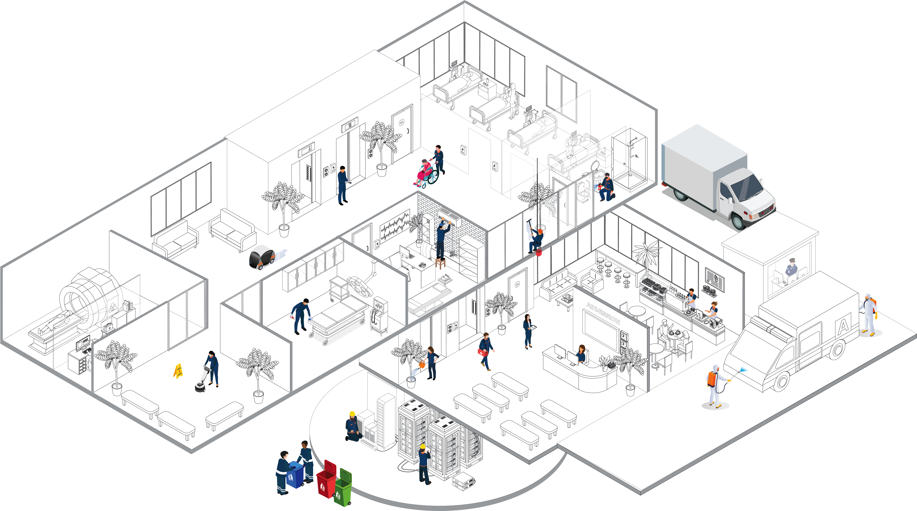
Healthcare
It starts with the lighting…..
Lighting | Operational Management / Environmental
Provides the backbone mesh network for the additional sensors with controls. Add all information relating to emergency lighting, ambient lighting, controls, mesh backbone etc into this box and make full size to bottom of the page,
Monitoring & Control

Slide 15
Then your options are endless
Occupancy Levels | Operational Management
Management of areas such as meeting rooms or hot desks, tracking a customer’s journey notifying you where your staff need to be deployed relevant to time of the day
Monitoring & Alert
Washroom Usage | Operational Management
Counts number of people entering washrooms allowing for the creation of dynamic cleaning schedules based on usage
Monitoring & Alert
External | Environmental
Monitoring external environmental conditions to feed into the data analytics and optimise assets and wellness
Monitoring
Waste Bins | Operational Management
Management of waste levels within bins, optimising your collection/emptying routine
Monitoring & Alert
Leaks | PPM Maintenance
Monitoring areas for water ingress, sending automatic alerts direct to you
Alerts
Air Quality | Environmental
Measuring Temperature, CO2, noise, PMs, humidity and allowing for the setting of benchmarks to improve building wellness
Monitoring
Lighting | Operational Management / Environmental
Monitoring light levels, creating dynamic lighting schedules and automated testing
Monitoring
Infrared Detection | Safety
Alert to spills - avoidance of H&S incidents
Alerts
Doors & Windows | Safety & Security
Security monitoring, reporting on doors and windows that are open or closed, locked and unlocked.
Alerts
Water | Safety
Routine Legionalla testing, monitoring tap temperatures and flow 24/7 to create a virtual PPM regime
Monitoring & Alert
Equipment | Operational Management
Monitoring, measuring and reporting equipment details for usage reporting, tracking where equipment is around site and understanding performance levels of robotics
Monitoring & Alert
Assets | PPM / Maintenance
Monitoring asset condition and health, allowing you to stay ahead of any potential risk and auto allocating reactive tasks including instructions of what is wrong and how to repair allowing you to move away from a strict SFG20 regime
Monitoring & Alert
Optical Analytics | PPM Maintenance
Monitoring the security of a building in realtime, creating alerts based on behaviours
Alerts

Slide 16

Challenges in Mental and Secure Healthcare
Environments must be safe for vulnerable individuals while still supporting healing and dignity. Products like the Lucca anti-ligature range combine robust, tamper-proof and anti-ligature design with dynamic, supportive lighting that promotes calm and normality.
Well-being and rehabilitation are important elements, whilst ensuring lighting fits within institutional protocols. Lighting within mental healthcare can unintentionally reinforce feelings of confinement. Melagen-enabled fittings produce warm, low-blue light in the evenings and blue-enriched light during the day, creating a natural day/night ambience that mirrors life outside.
Staff cannot be expected to manually manage lighting schedules, especially in high-pressure care environments. Melagen automatically shifts colour temperature and blue light content through the day with no user intervention required and can be integrated with existing control systems (DALI2, MyMesh, Bluetooth etc).
Imagine the benefits that can be generated by illuminating permanently occupied spaces such as within mental healthcare via science-based lighting solutions, where the residents can benefit from restored and maintained wake/sleep cycles and all of the documented benefits of a healthy circadian cycle.

Slide 17

Thank You
Speaker: Lee McCarthy
lightyearsahead.co.uk
info@lightyearsahead.co.uk

