Slide 1

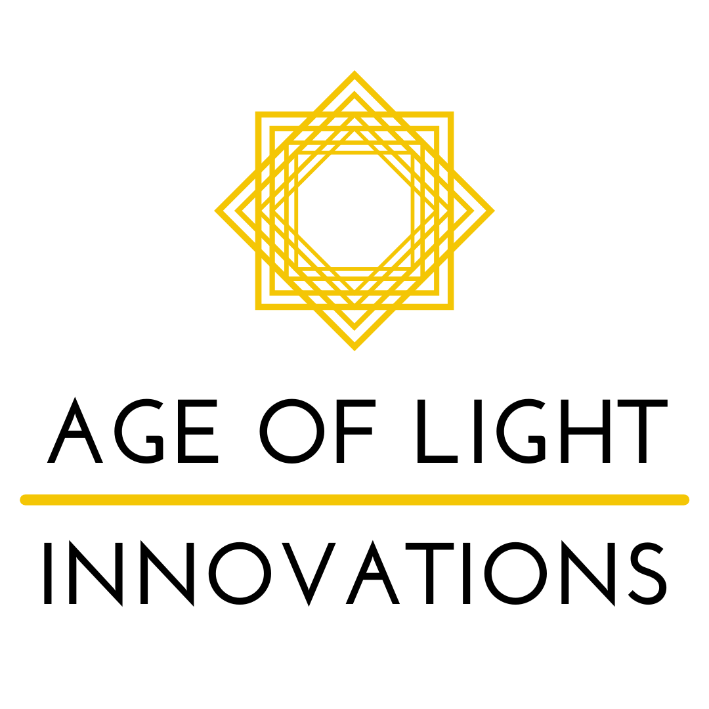
Lighting for Mental Health: From The Science and Practical Implementation to Sustainability
Dr Shelley James
10 February

Slide 2

Why should you care about boring old lightbulbs?
Notes:
How many of you run hospitals?
How many of you run teams?
How many of you are worried about the electricity bill?

Slide 3
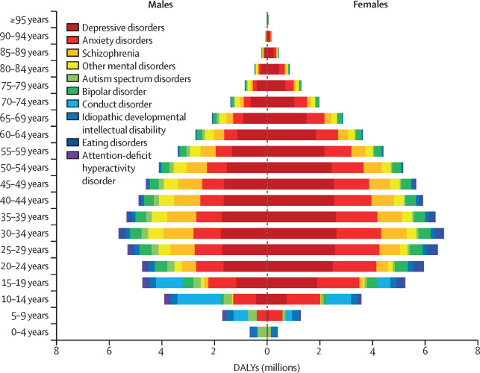
Global, regional, and national burden of 12 mental disorders in 204 countries and territories, 1990&#x2013;2019: a systematic analysis for the Global Burden of Disease Study 2019. (2022). The Lancet Psychiatry, 9(2), 137-150. https://doi.org/10.1016/S2215-0366(21)00395-3

Slide 4
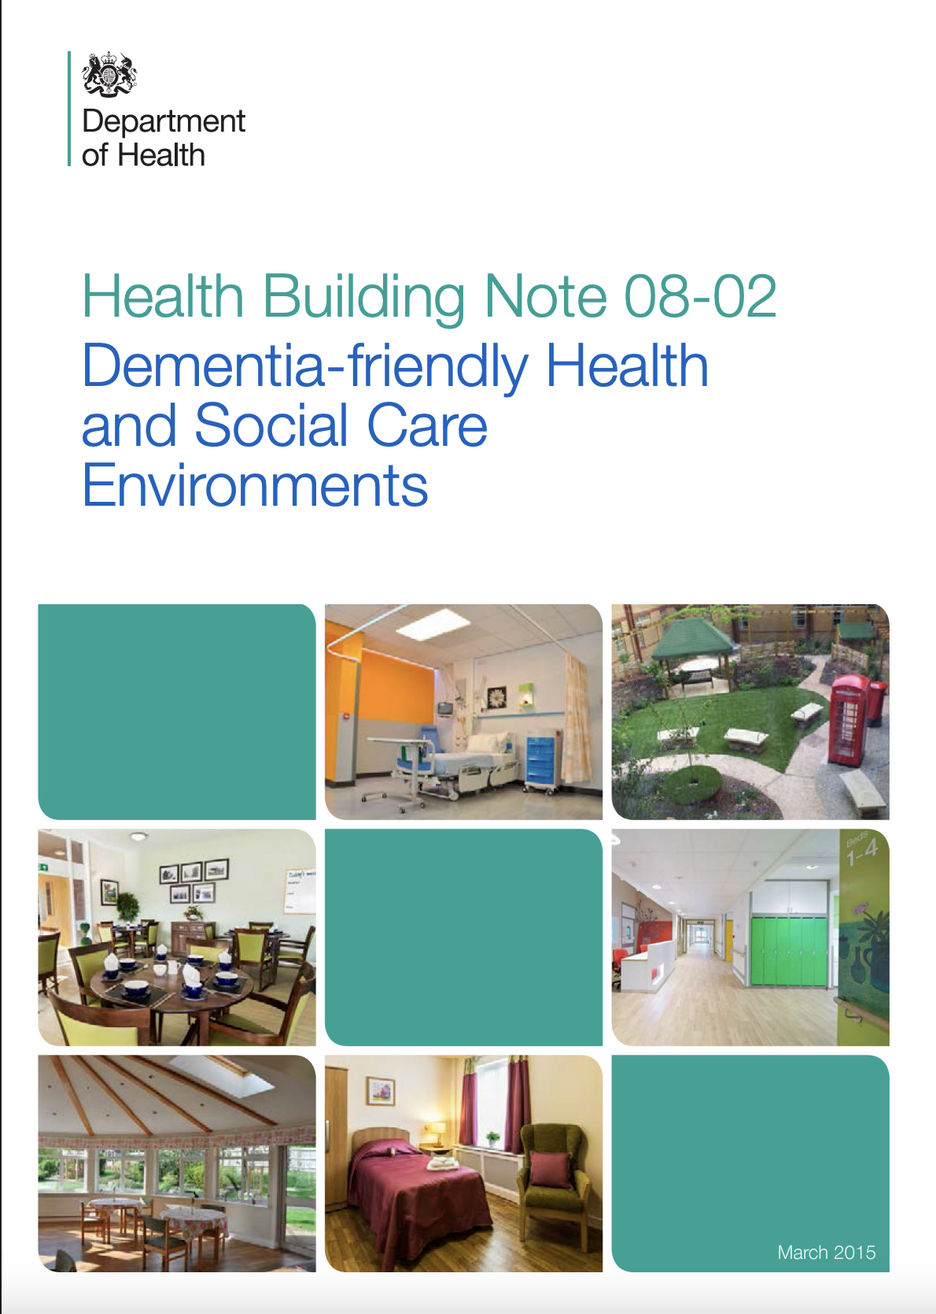
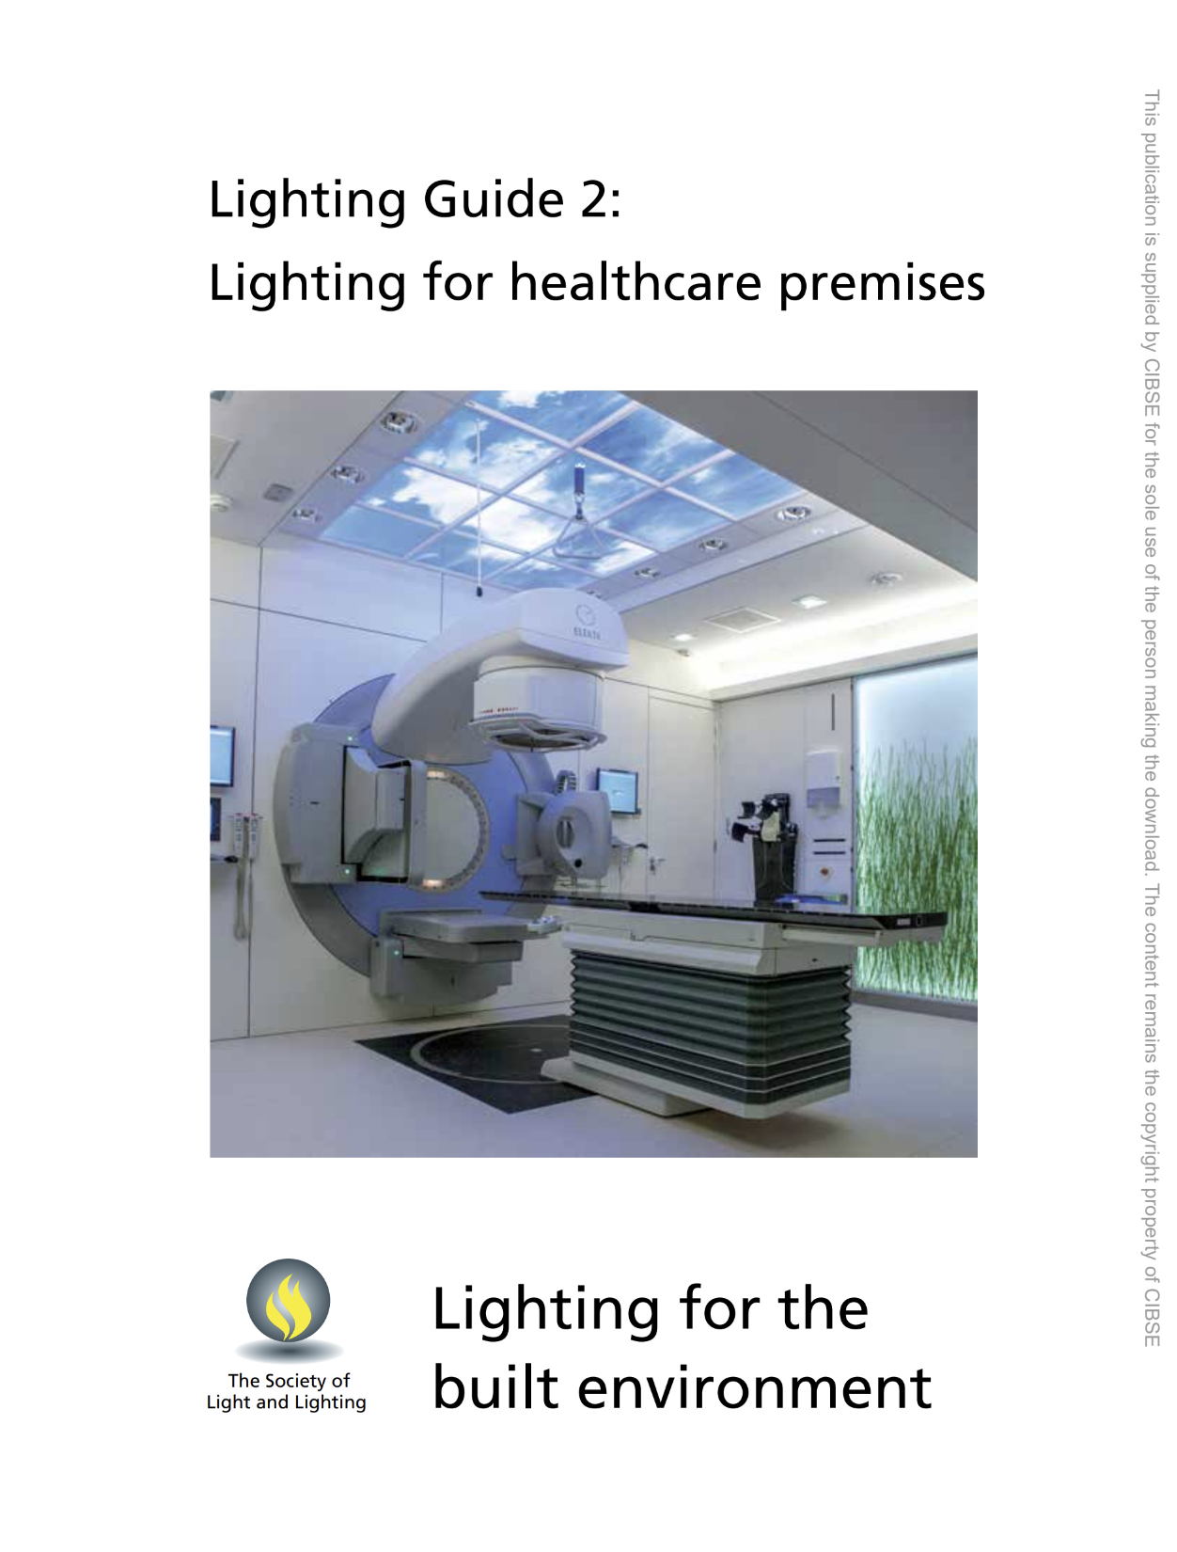
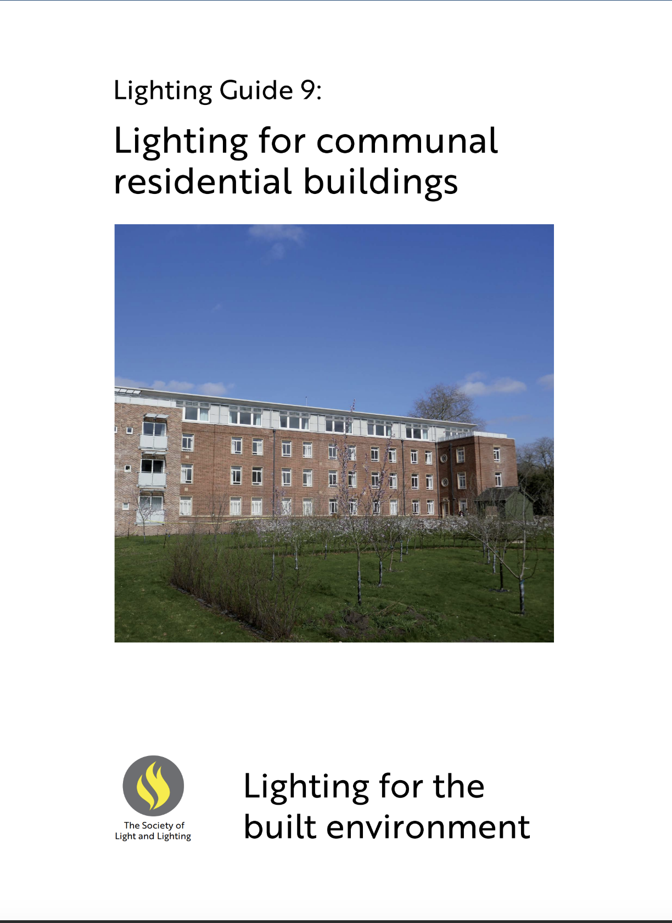


https://www.hse.gov.uk/humanfactors/topics/lighting.htm
https://www.cibse.org/
Notes:
Slide 7 – why the picture of a DEC? Currently this is not directly linked to comfort, it is an energy metric.
Agreed - removed that one -
Here in the UK - HSE and SLL have similar relationship to the ANSI/IES and issue guidance for different applications.

Slide 5
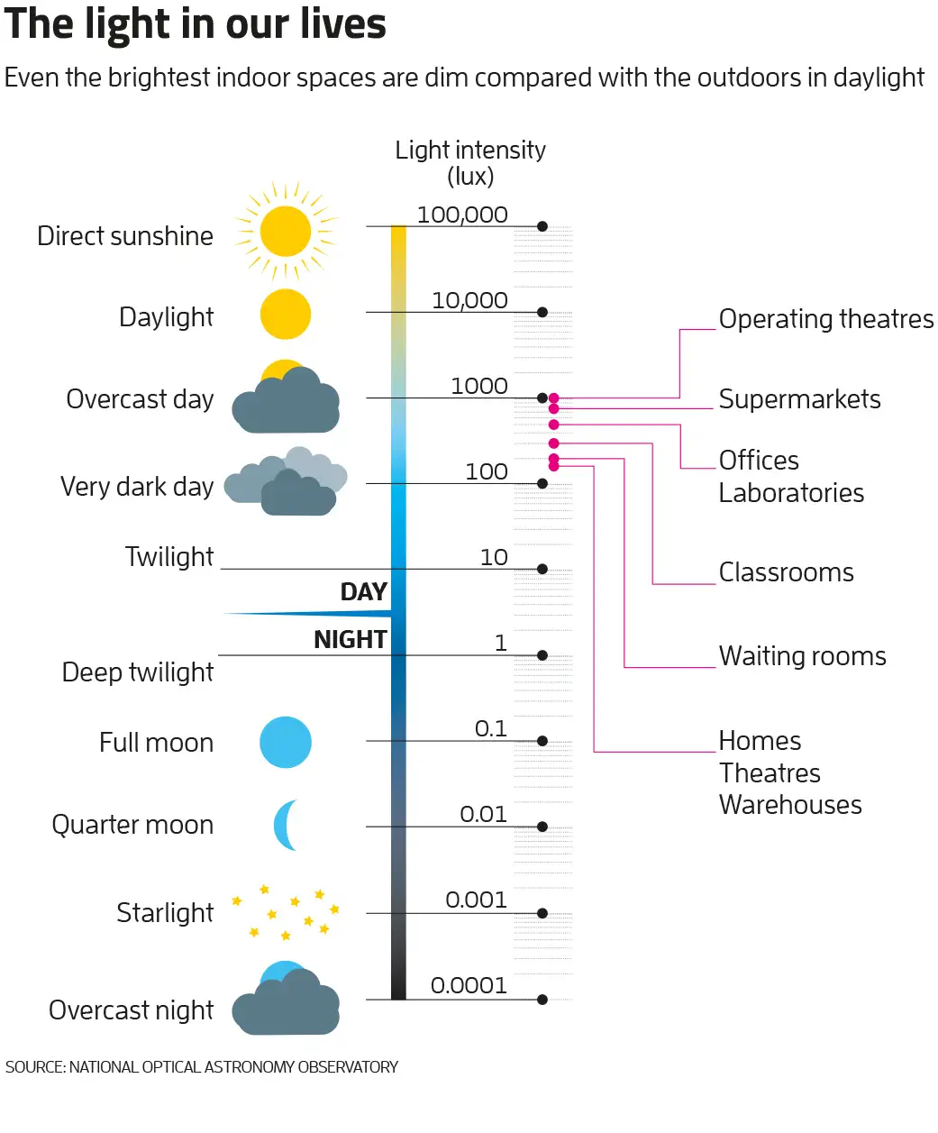
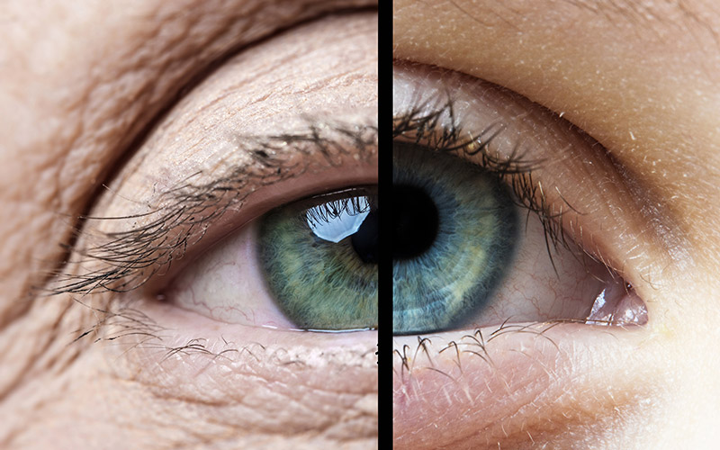
Specified for visual performance

Slide 6
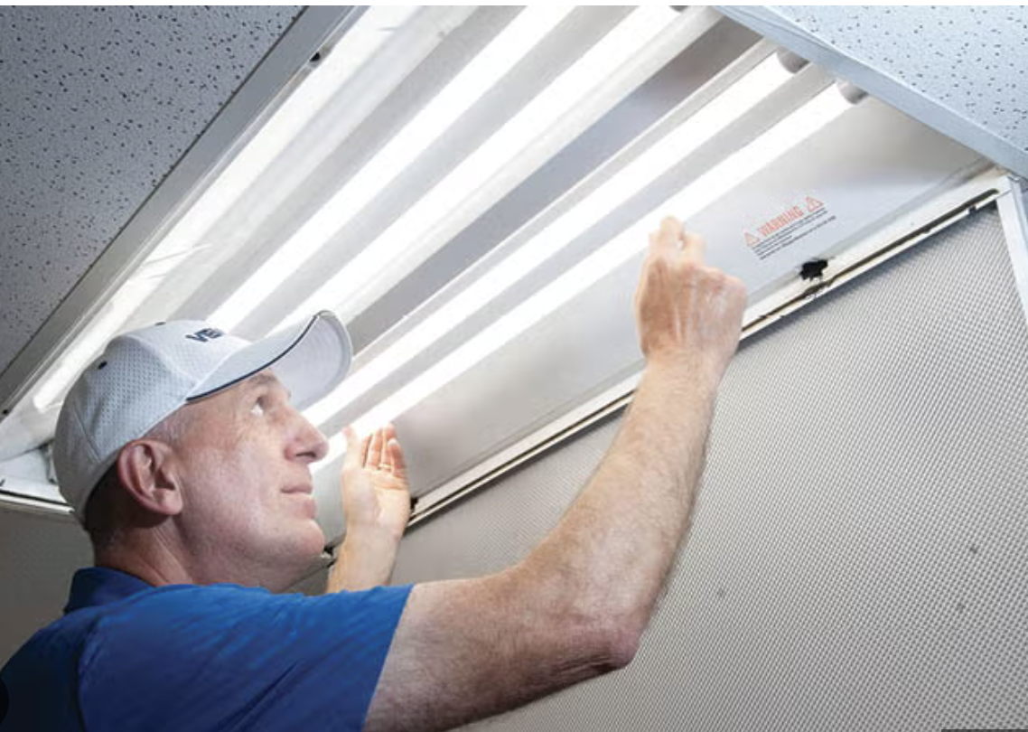
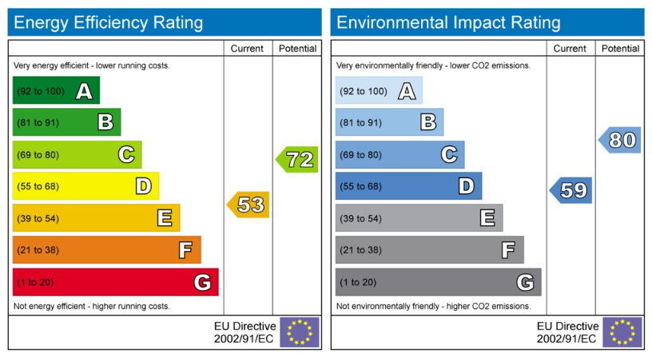
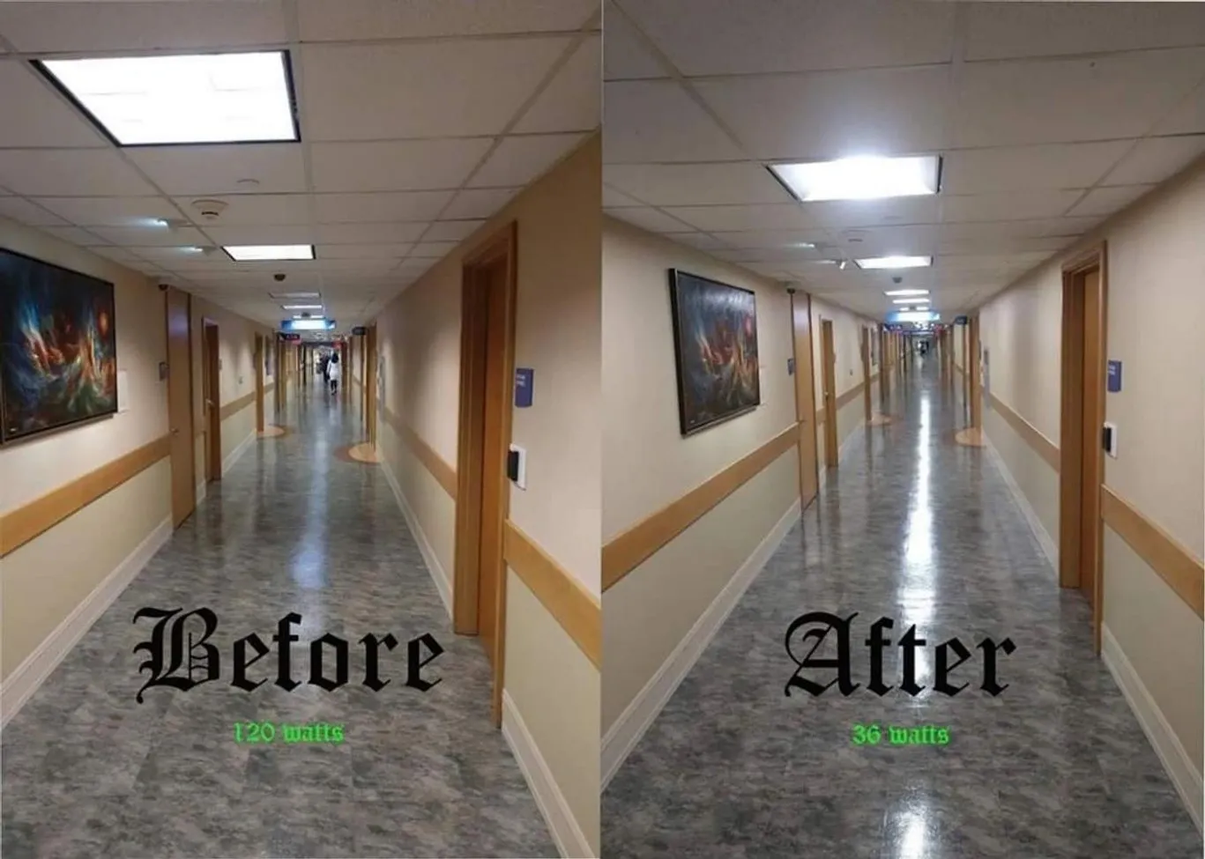
Efficiency and convenience
https://emtlighting.com/gallery/

Slide 7
Lack of education and awareness…
Significant impact on anticipated quality of care, disclosure and comfort…
But
“Few therapists reported any design education about counseling environments and none about the waiting room.”
Noble, L., & Devlin, A. S. (2021). Perceptions of Psychotherapy Waiting Rooms: Design Recommendations. HERD: Health Environments Research & Design Journal, 14(3), 140-154. https://doi.org/10.1177/19375867211001885

Slide 8
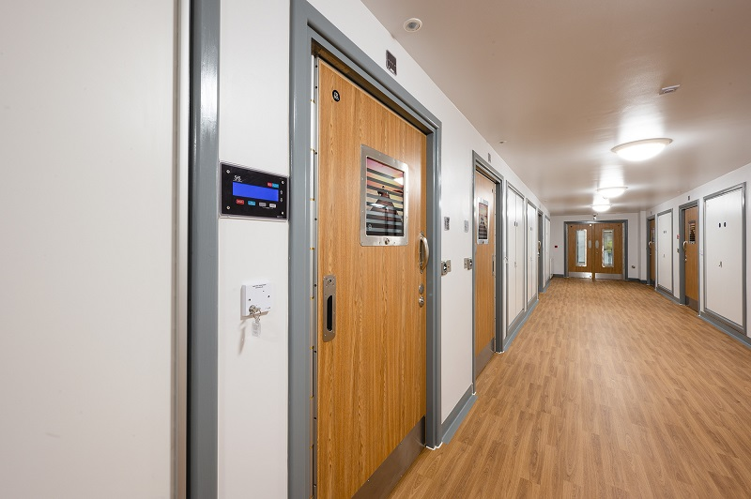
https://buildingbetterhealthcare.com/first-new-mental-health-ward-opens-in-worcestershire-204108

Slide 9
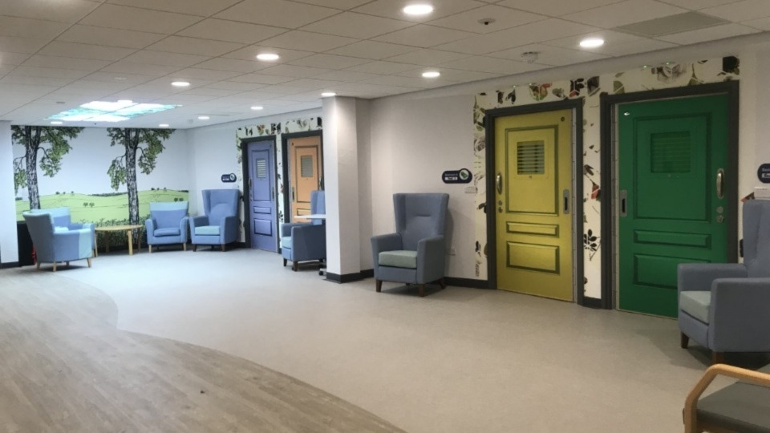

Slide 10
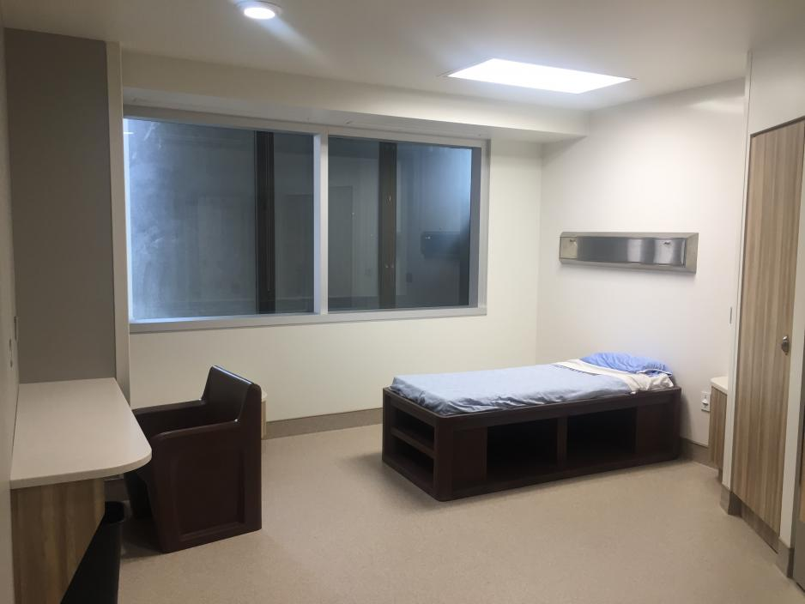

Slide 11

Can’t we do better…?

Slide 12
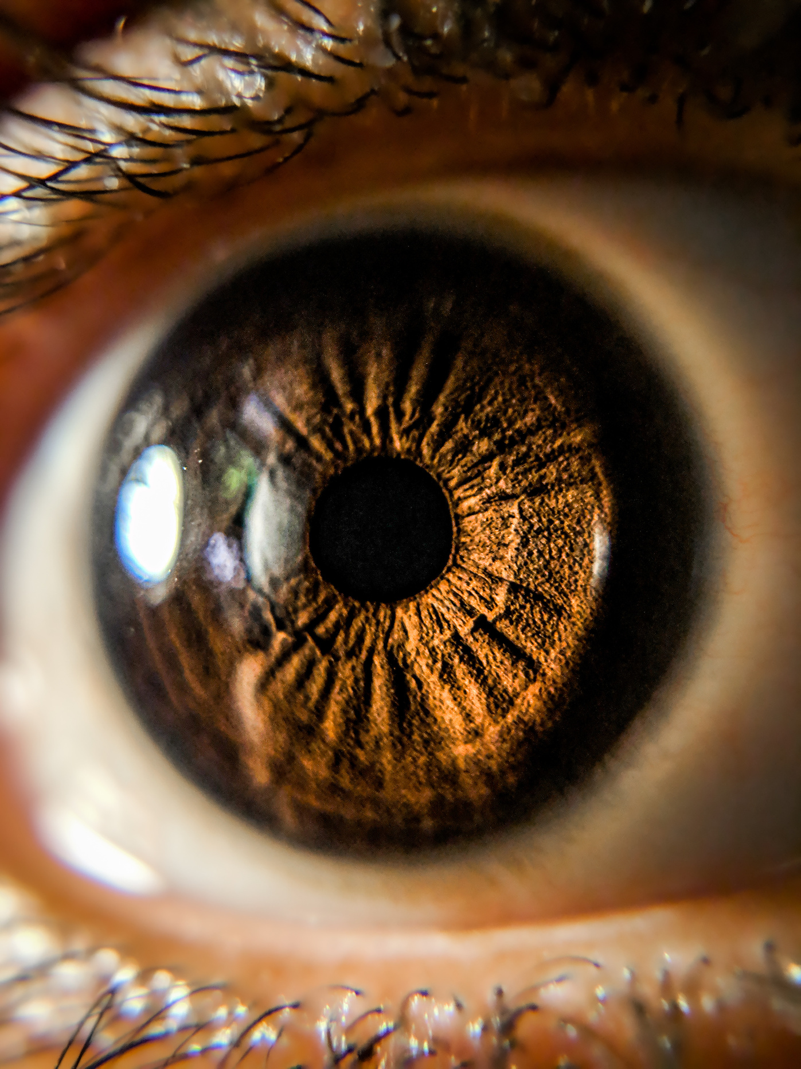
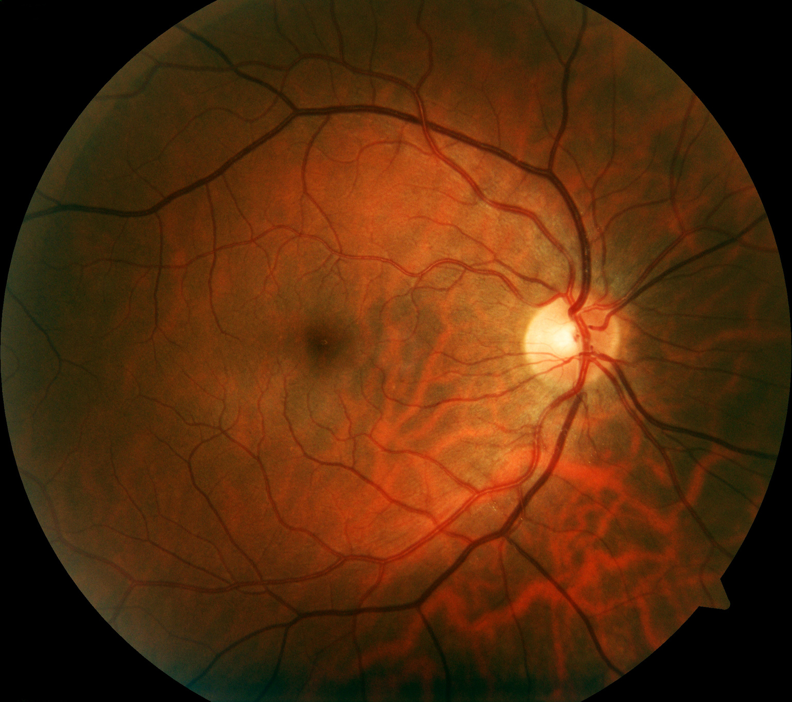
Notes:
In humans, the light-sensing system is primarily driven by a piece of brain tissue floating in the back of the eye, held in place by pressure from the vitreous humour - the jelly-like substance that lies behind the lense - it starts to grow in the first weeks of life.
Early space travel research used the retina as non-invasive system to measure brain function.

Slide 13
Notes:
The cutaway diagram shows the basic arrangement -
The back layer is covered with rods and cones that send messages to the visual cortex for processing. It responds incredibly quickly to changes in light level, colour, movement (including flicker)
The top layer is a ‘relay’ station before the signals are sent back to the brain.
Around 5% of those cells in the top layer are sensitive to light in their own right. That’s why they are called ‘intrinsically photosensitive’ - or IPRGs. These signals run along a parallel pathway to a set of signalling and regulating systems in the centre of the brain.

Slide 14
Gronfier, C., The good blue and chronobiology: light and non-visual functions, Points de Vue, International Review of Ophthalmic Optics, N68, Spring, 2013
Notes:
These structures, including the SCN (or supra-chiasmatic nucleus) regulates the sleep-wake cycle and a complex cocktail of hormones including dopamine, adrenaline and serotonin. Scientists are still learning how this works but the more we learn the more powerful this ‘non-image forming’ system seems to be.

Slide 15

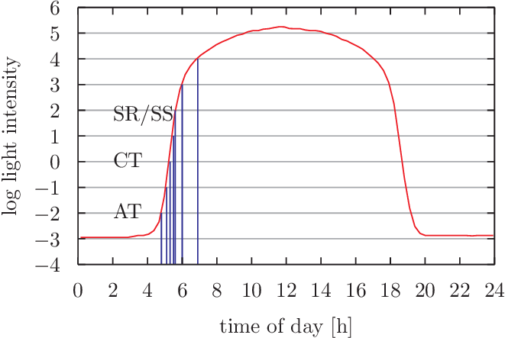
Engelmann, W., & Antkowiak, B. (2016). Flower clocks, time memory and time forgetting. https://doi.org/10.15496/publikation-9218

Slide 16



Slide 17
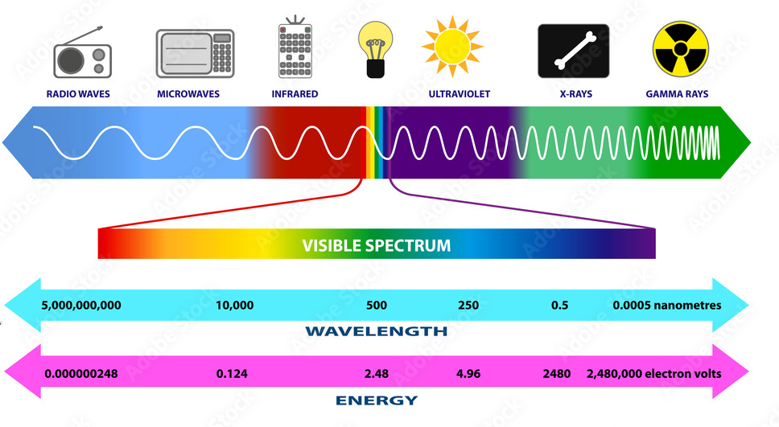

Slide 18

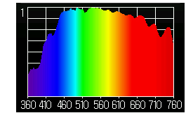
https://www.sunlightinside.com/light-and-health/natural-light-vs-artificial-light/

Slide 19
‘Sky blue’
Mure L. S. (2021). Intrinsically Photosensitive Retinal Ganglion Cells of the Human Retina. Frontiers in neurology, 12, 636330. https://doi.org/10.3389/fneur.2021.636330
Notes:
We also know they have a peak sensitivity to around 480 nanometers - although note overlapping sensitivity curves for rods, cones and ipRGCS- not an ‘on-off’ switch. We’ll talk more about how we know that in a minute -

Slide 20
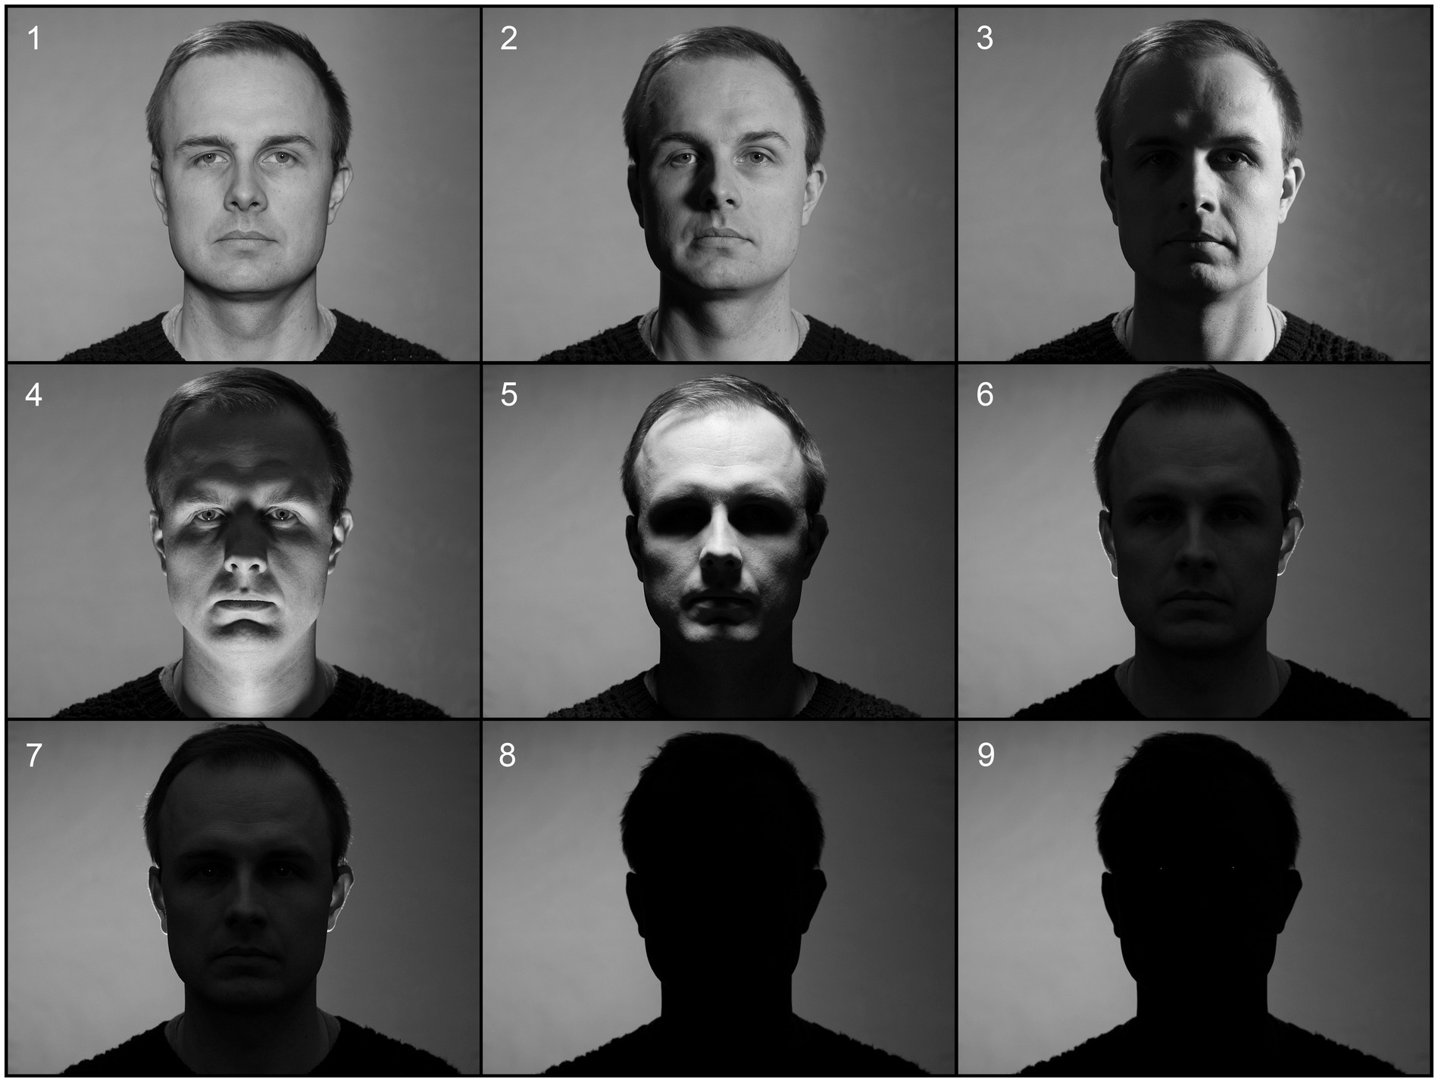
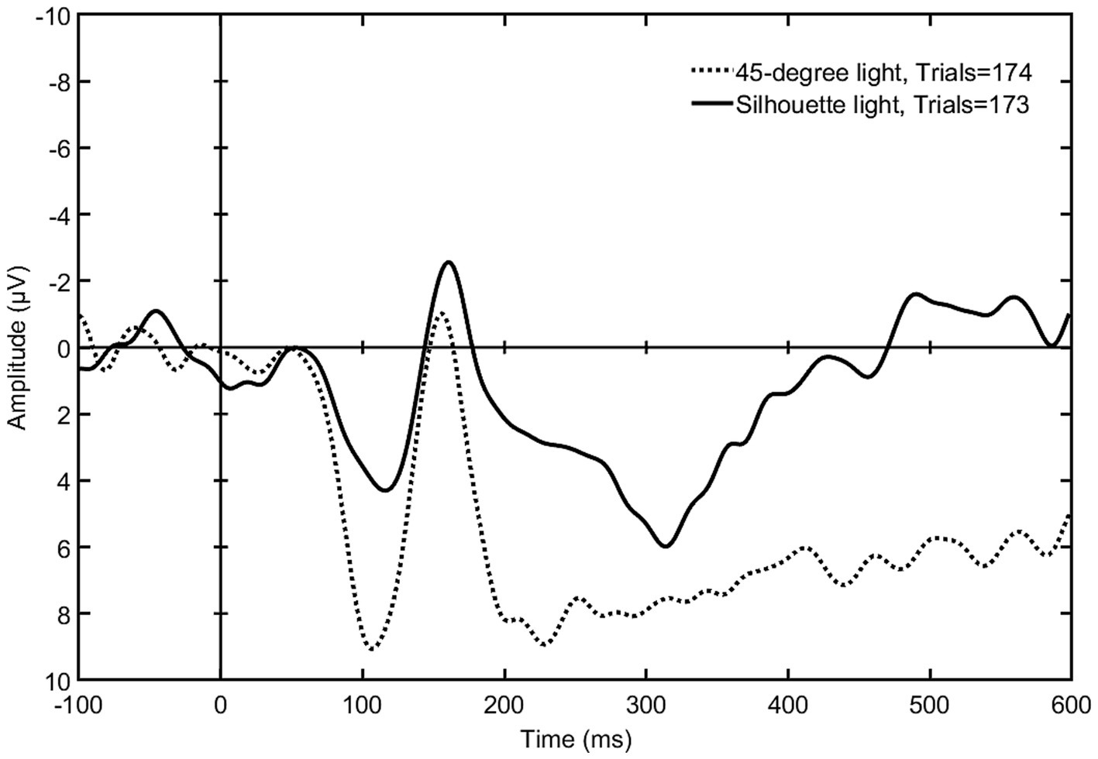
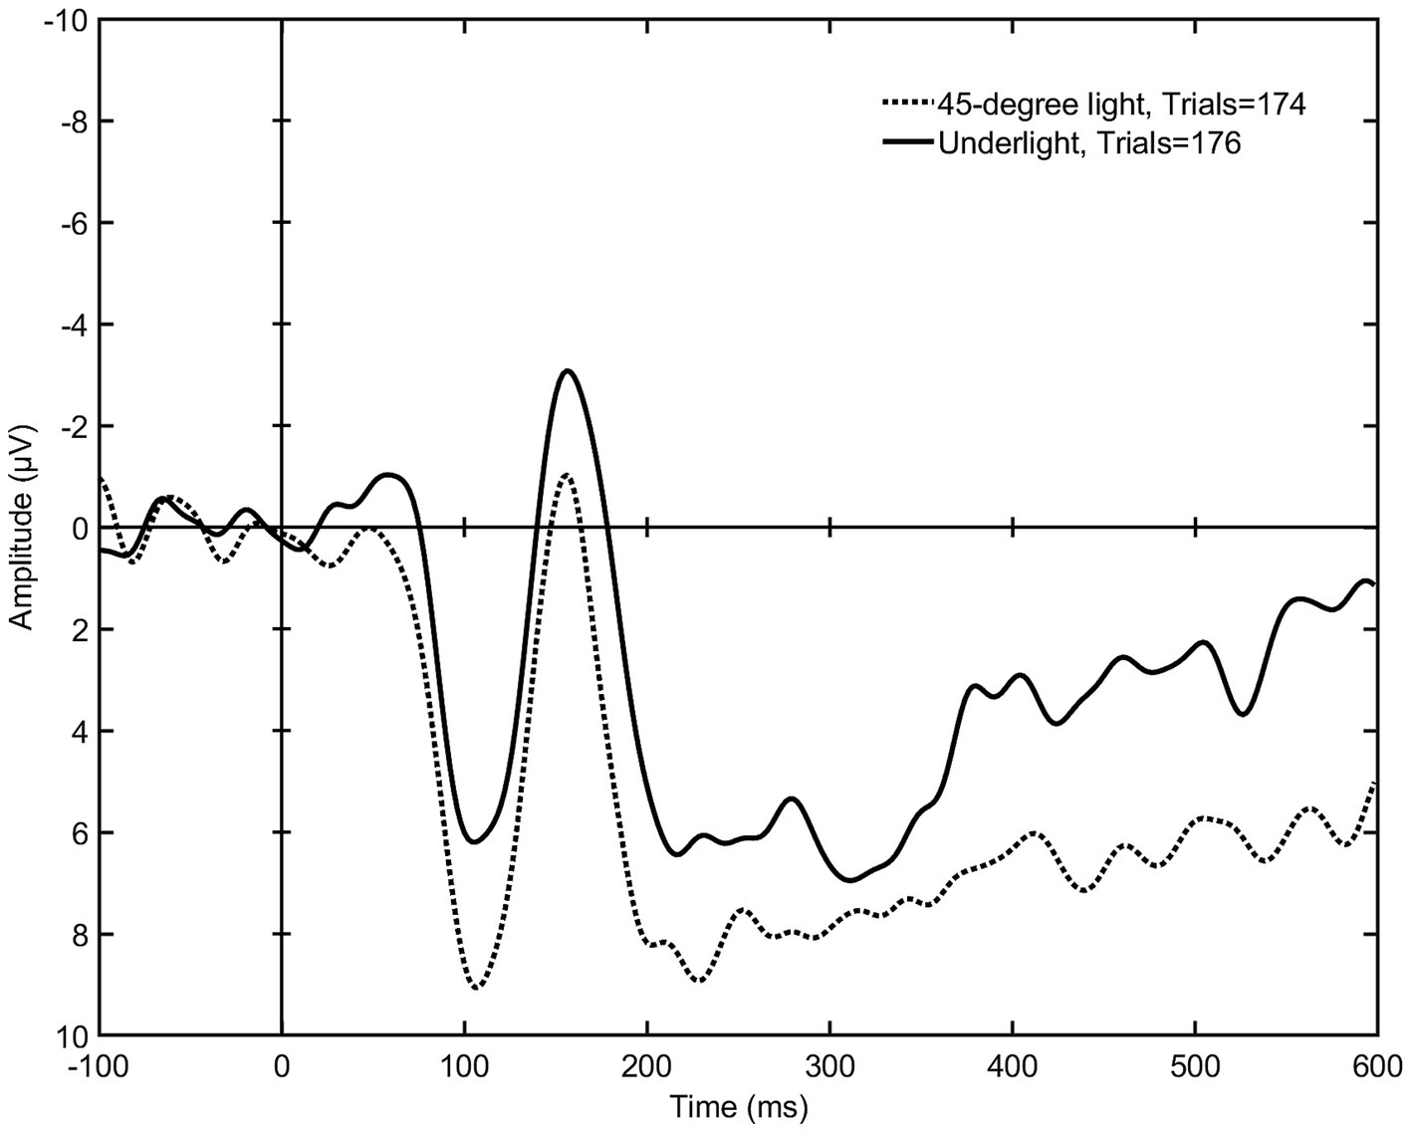
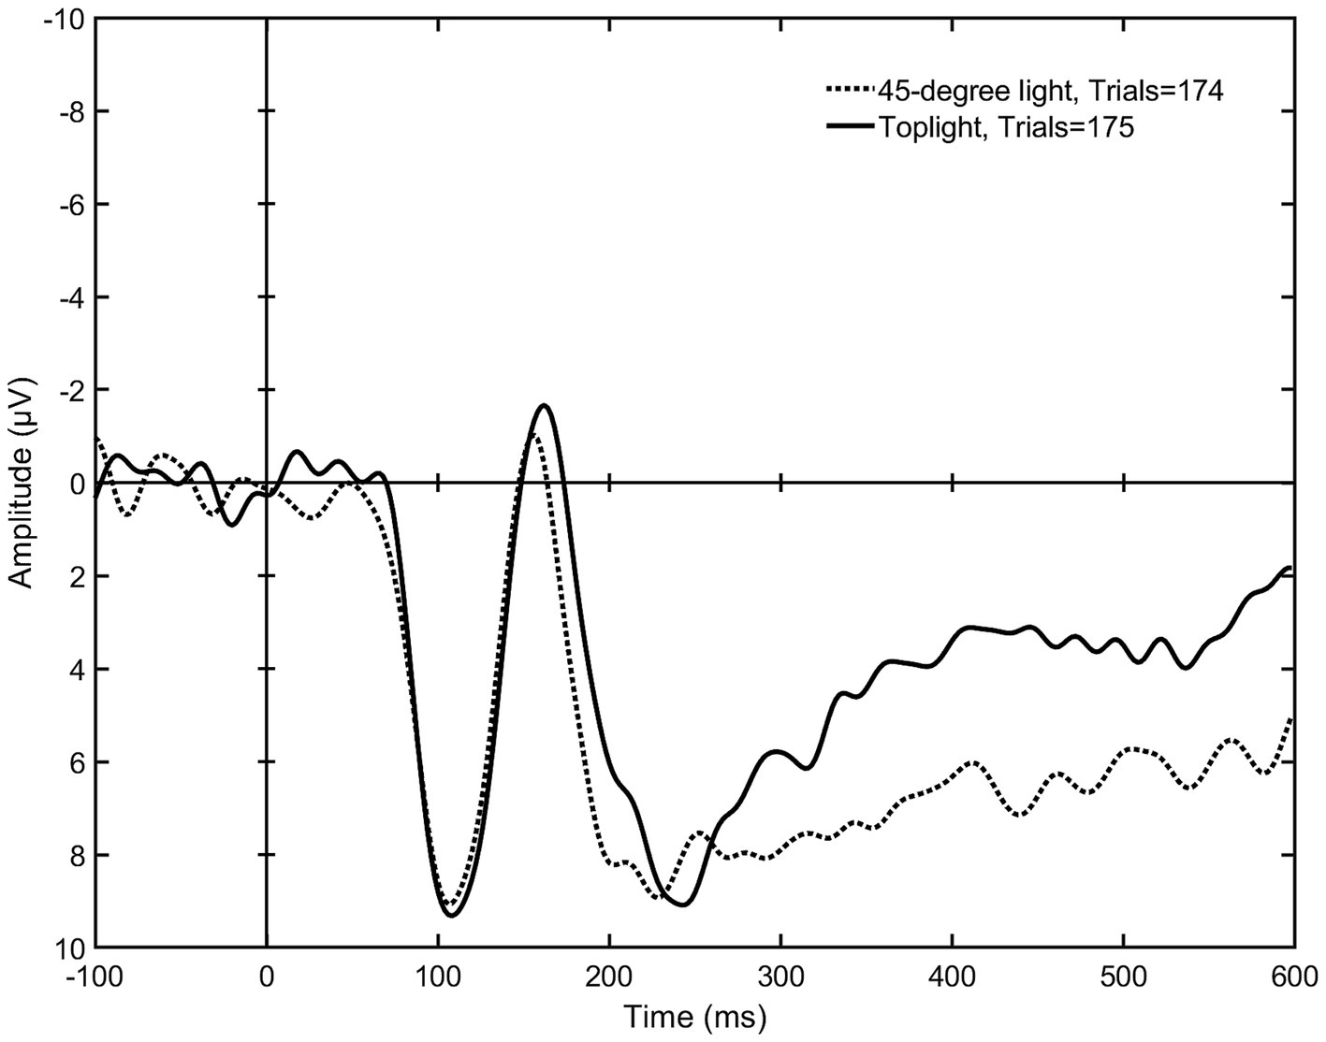
Priming for threat
Bagheri, S., Good, J., & Alavi, H. (2024). Visual and acoustic discomfort: A comparative study of impacts on individuals with and without ADHD using electroencephalogram (EEG). Building and Environment, 264, 111881. https://doi.org/10.1016/j.buildenv.2024.111881
S
Huttunen, S. (2025). Faces in shadows: silhouette light, underlight and toplight elicit increased early posterior negativity [Original Research]. Frontiers in Neuroscience, Volume 19 - 2025. https://doi.org/10.3389/fnins.2025.1553977
Notes:
Huttunen, S. (2025). Faces in shadows: silhouette light, underlight and toplight elicit increased early posterior negativity [Original Research]. Frontiers in Neuroscience, Volume 19 - 2025. https://doi.org/10.3389/fnins.2025.1553977

Slide 21
Notes:
One of the critical signals for a living creature is to tell whether it’s night or day -
So the light-sensing system evolved to identify cycles of light and dark -

Slide 22
Notes:
One of the critical signals for a living creature is to tell whether it’s night or day -
So the light-sensing system evolved to identify cycles of light and dark -

Slide 23
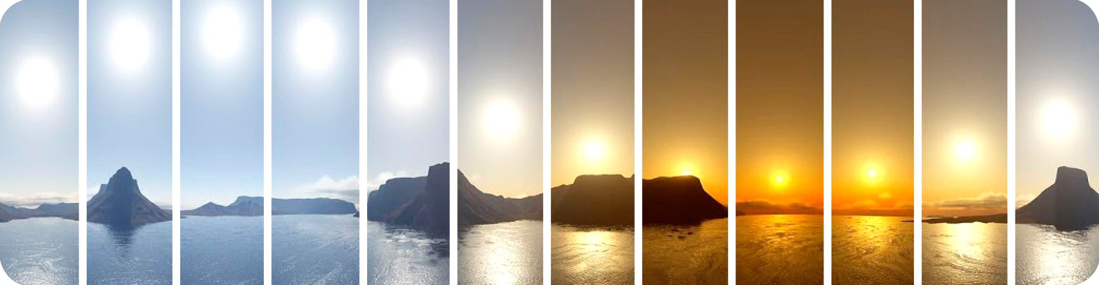
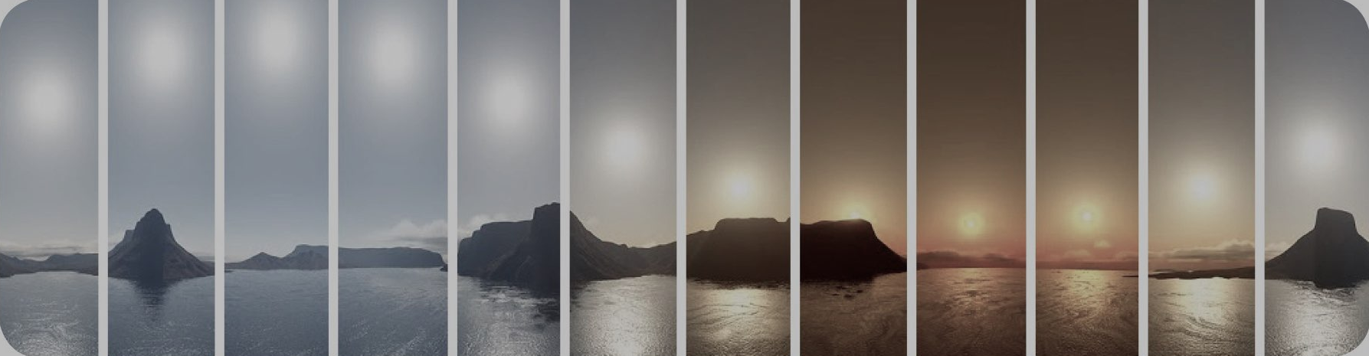
Darkness counts too!
Notes:
One of the critical signals for a living creature is to tell whether it’s night or day -
So the light-sensing system evolved to identify cycles of light and dark -

Slide 24
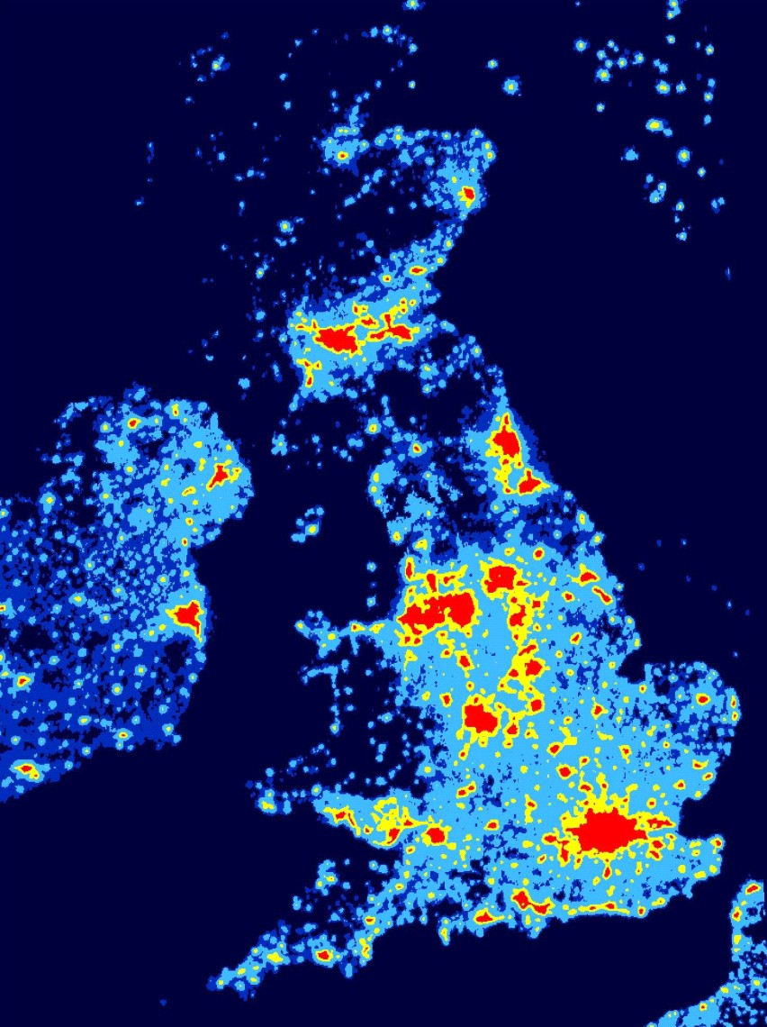
Artificial Light After Dark (indoors and outdoors) increases risk of depression
Chen, M., Zhao, Y., Lu, Q., Ye, Z., Bai, A., Xie, Z., Zhang, D., & Jiang, Y. (2024). Artificial light at night and risk of depression: a systematic review and meta-analysis. Environ Health Prev Med, 29, 73. https://doi.org/10.1265/ehpm.24-00257

Slide 25
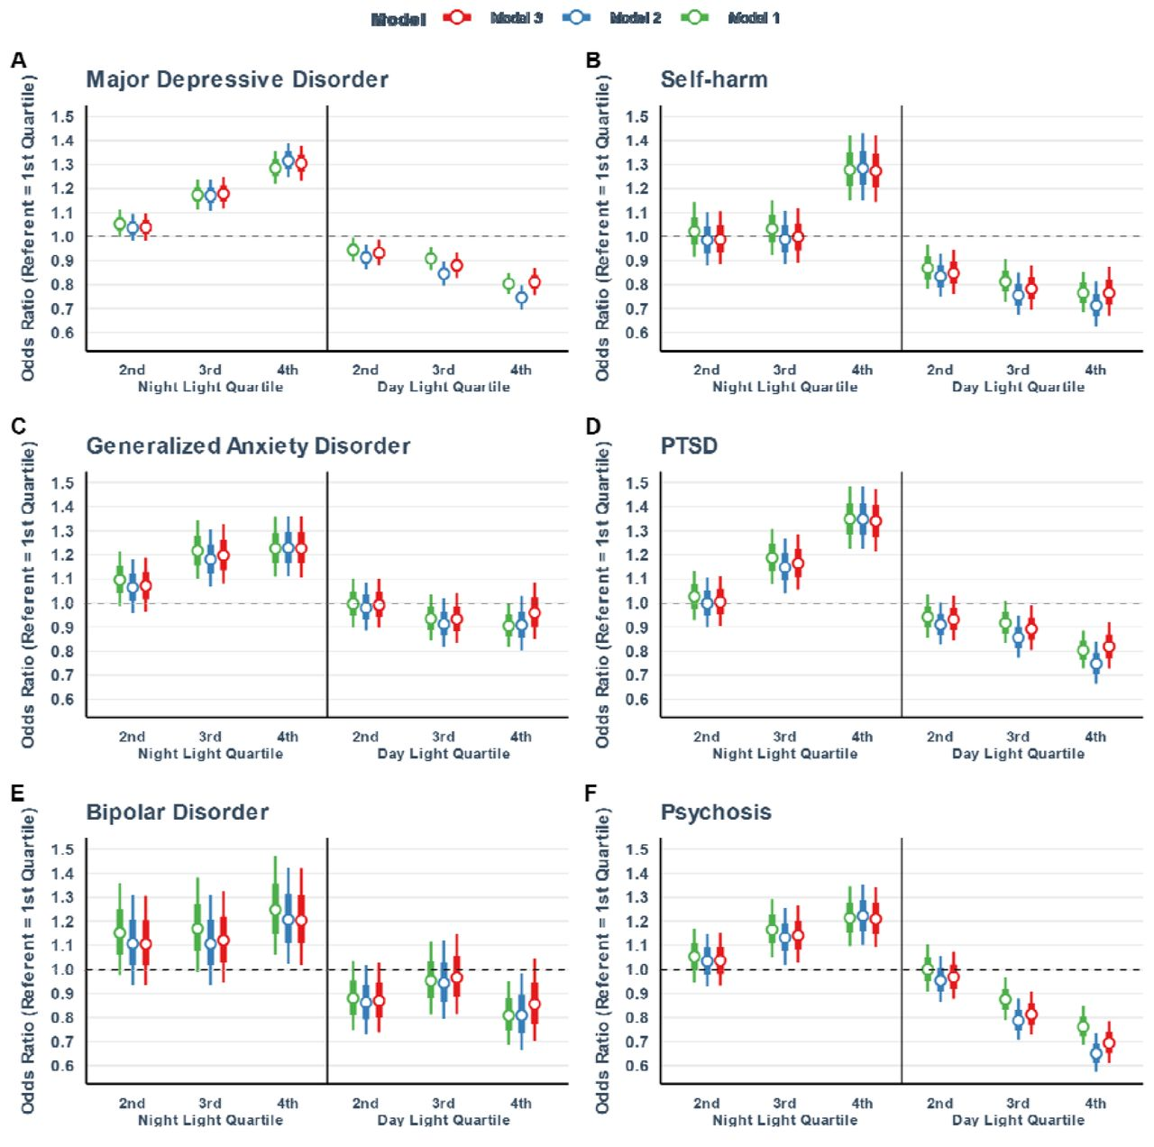
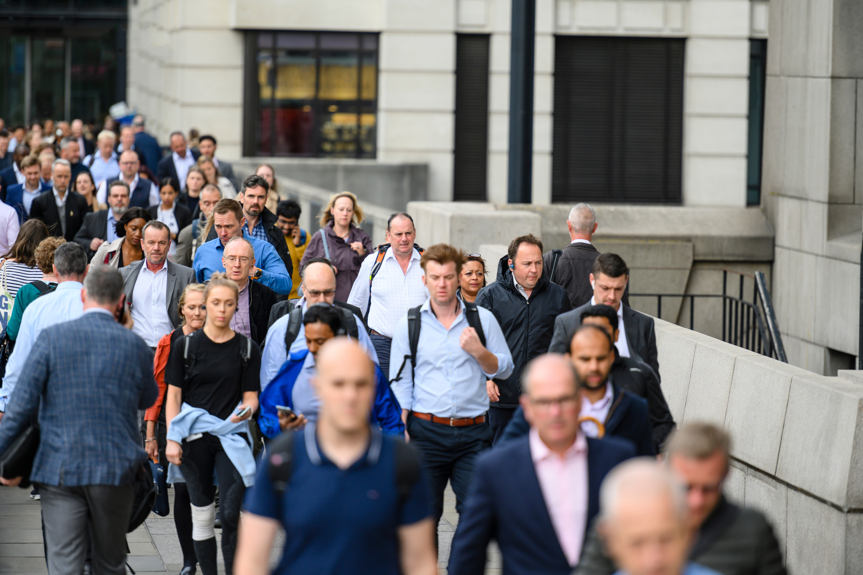
Biobank studies
= population-scale effects of bright days and dark nights on mental health
Burns, A. C., Windred, D. P., Rutter, M. K., Olivier, P., Vetter, C., Saxena, R., Lane, J. M., Phillips, A. J. K., & Cain, S. W. (2023). Day and night light exposure are associated with psychiatric disorders: an objective light study in >85,000 people. Nature Mental Health, 1(11), 853-862. https://doi.org/10.1038/s44220-023-00135-8

Slide 26
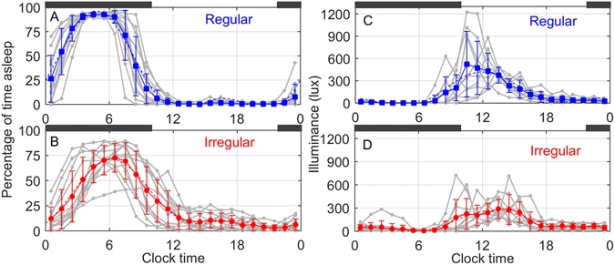
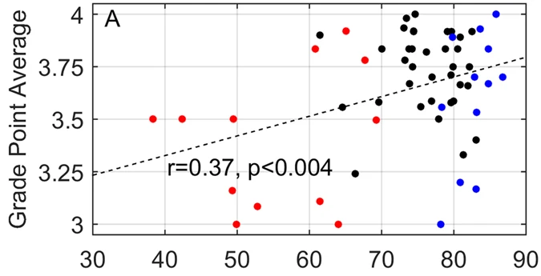
Academic performance…
=
confidence, social + economic outcomes
Phillips, A.J.K., Clerx, W.M., O’Brien, C.S. et al. Irregular sleep/wake patterns are associated with poorer academic performance and delayed circadian and sleep/wake timing. Sci Rep 7, 3216 (2017). https://doi.org/10.1038/s41598-017-03171-4
Notes:
Abstract
The association of irregular sleep schedules with circadian timing and academic performance has not been systematically examined. We studied 61 undergraduates for 30 days using sleep diaries, and quantified sleep regularity using a novel metric, the sleep regularity index (SRI). In the most and least regular quintiles, circadian phase and light exposure were assessed using salivary dim-light melatonin onset (DLMO) and wrist-worn photometry, respectively. DLMO occurred later (00:08 ± 1:54 vs. 21:32 ± 1:48; p < 0.003); the daily sleep propensity rhythm peaked later (06:33 ± 0:19 vs. 04:45 ± 0:11; p < 0.005); and light rhythms had lower amplitude (102 ± 19 lux vs. 179 ± 29 lux; p < 0.005) in Irregular compared to Regular sleepers. A mathematical model of the circadian pacemaker and its response to light was used to demonstrate that Irregular vs. Regular group differences in circadian timing were likely primarily due to their different patterns of light exposure. A positive correlation (r = 0.37; p < 0.004) between academic performance and SRI was observed. These findings show that irregular sleep and light exposure patterns in college students are associated with delayed circadian rhythms and lower academic performance. Moreover, the modeling results reveal that light-based interventions may be therapeutically effective in improving sleep regularity in this population.
Lower average light intensity during the day and evening exposure greater than 10 lux impacts sleep: harder to fall asleep, less sleep, worse quality sleep, circadian intervention (bright light during the morning before 9am) improves sleep.

Slide 27
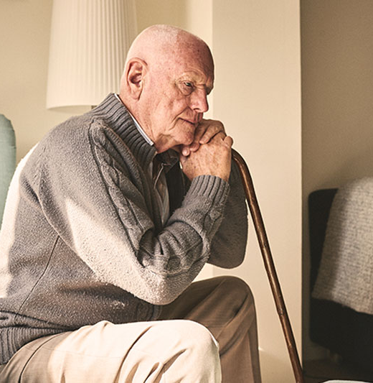
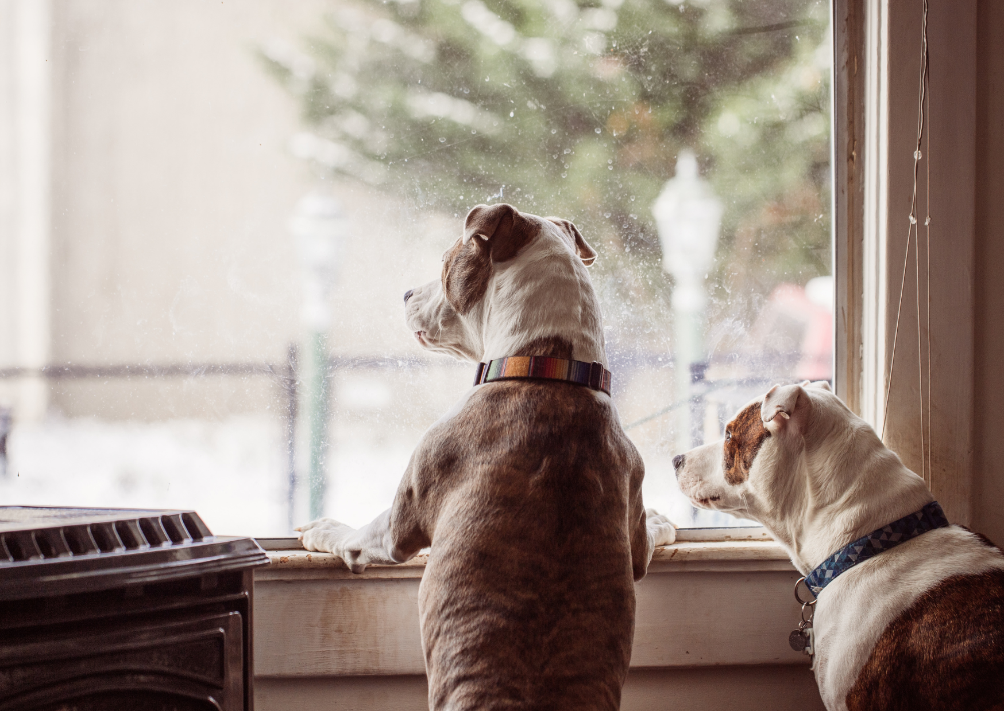
Outside is best - but a luxury for many…
2,000 residents in 40 nursing homes,
of those who were physically able,
22% went outside daily
32% went outdoors < 1x month
van den Berg, M. E. L., Winsall, M., Dyer, S. M., Breen, F., Gresham, M., & Crotty, M. (2019). Understanding the Barriers and Enablers to Using Outdoor Spaces in Nursing Homes: A Systematic Review. The Gerontologist, 60(4), e254-e269. https://doi.org/10.1093/geront/gnz055

Slide 28
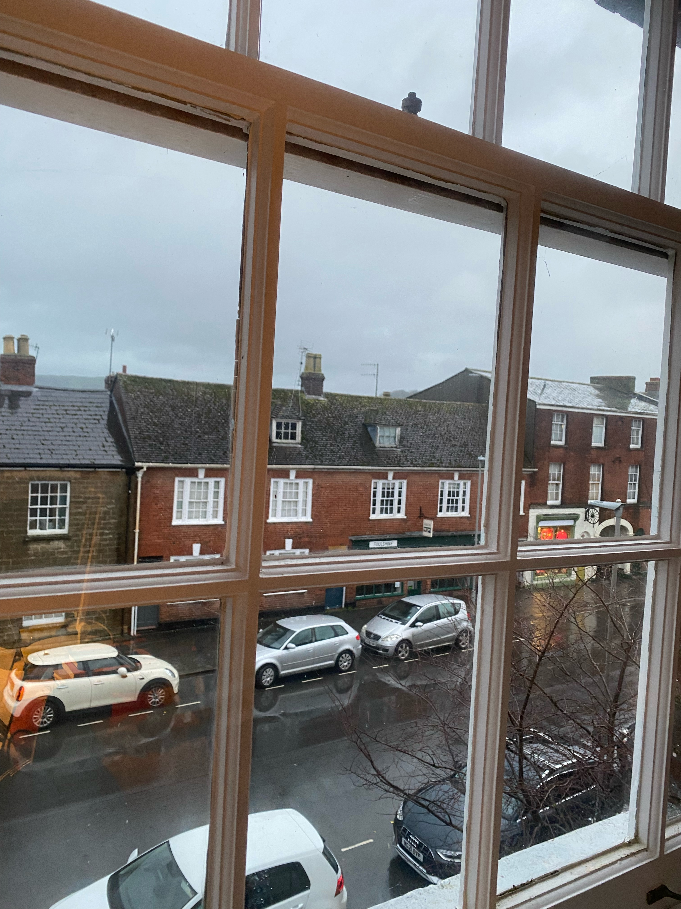
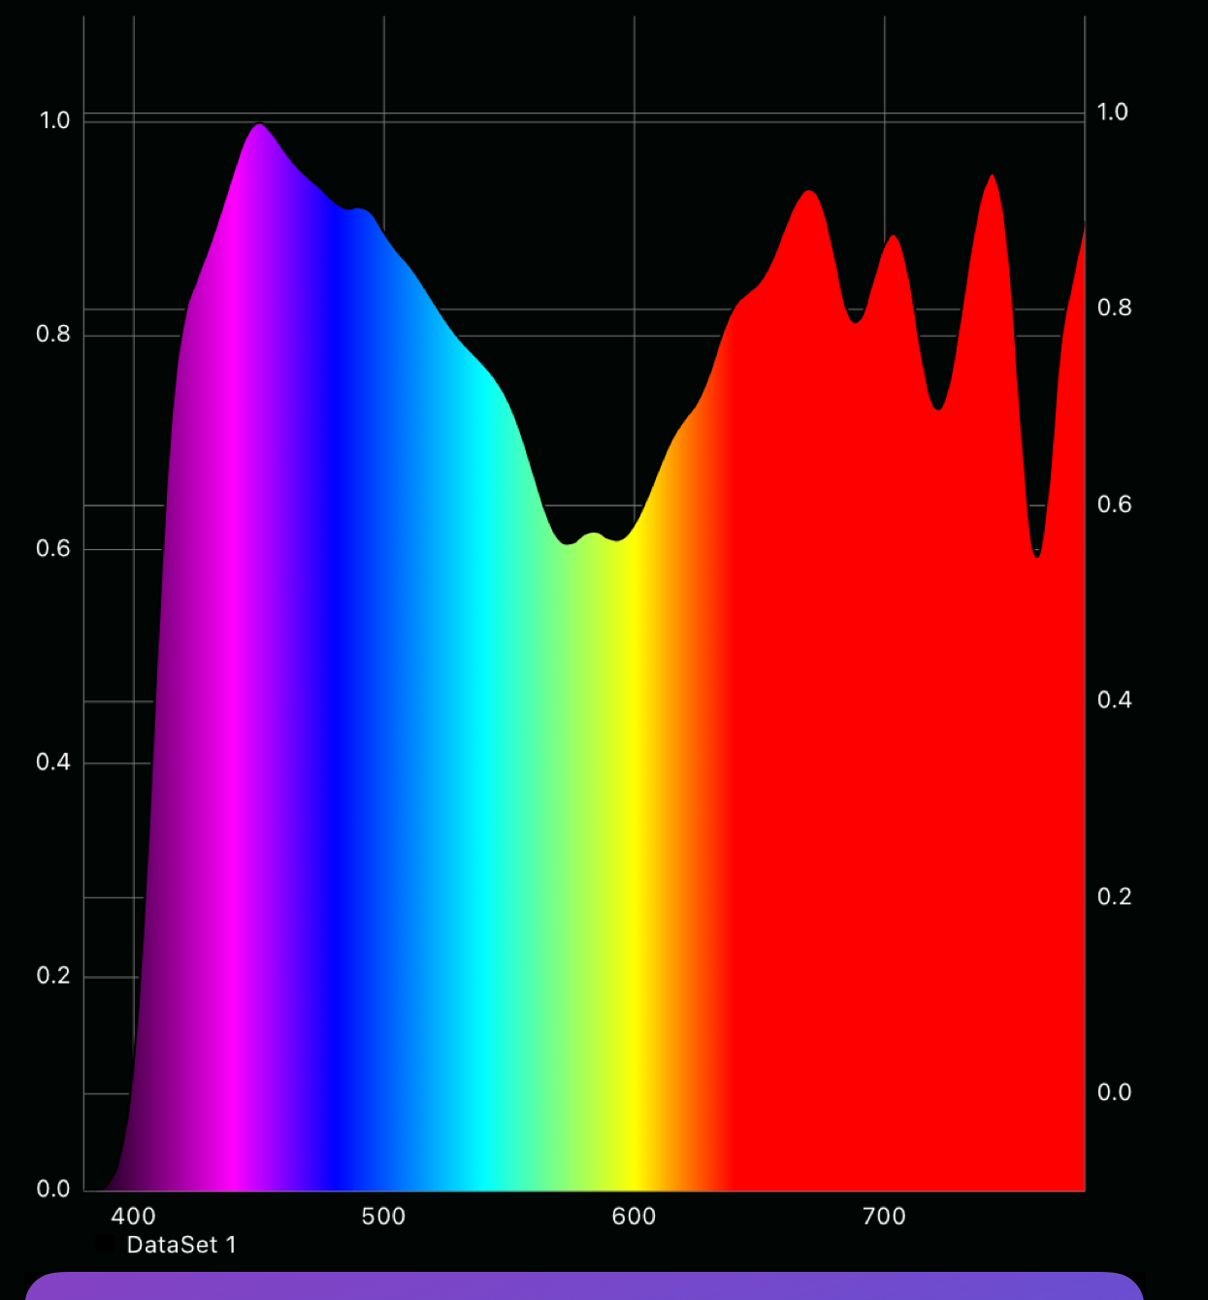
Windows can help… even on a rainy day!
Notes:
Day, J. K., Futrell, B., Cox, R., Ruiz, S. N., Amirazar, A., Zarrabi, A. H., & Azarbayjani, M. (2019). Blinded by the light: Occupant perceptions and visual comfort assessments of three dynamic daylight control systems and shading strategies. Building and Environment, 154, 107-121. https://doi.org/https://doi.org/10.1016/j.buildenv.2019.02.037
Rehman, S., Chani, P., Elangovan, R., & Kolay, S. (2025). The impact of daylight on cognitive performance: A study using HRV and pupillometry. Journal of Physics: Conference Series, 3140, 122012. https://doi.org/10.1088/1742-6596/3140/12/122012

Slide 29
Reduces sick leave in offices
Poor ratings of light quality and poorer views account for 6.5% of variation in sick leave.
Elzeyadi, I. (2012). Health and healing impacts of daylight in the workplace. World health.
Notes:
Day, J. K., Futrell, B., Cox, R., Ruiz, S. N., Amirazar, A., Zarrabi, A. H., & Azarbayjani, M. (2019). Blinded by the light: Occupant perceptions and visual comfort assessments of three dynamic daylight control systems and shading strategies. Building and Environment, 154, 107-121. https://doi.org/https://doi.org/10.1016/j.buildenv.2019.02.037
Rehman, S., Chani, P., Elangovan, R., & Kolay, S. (2025). The impact of daylight on cognitive performance: A study using HRV and pupillometry. Journal of Physics: Conference Series, 3140, 122012. https://doi.org/10.1088/1742-6596/3140/12/122012

Slide 30
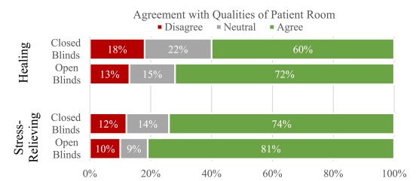


Reduces length of stay in hospital…
Daylight satisfaction
+ 74% room rating
+ 78% hospital rating
+ 60% quality of care
Guest JF, Keating T, Gould D, Wigglesworth N. Modelling the annual NHS costs and outcomes attributable to healthcare-associated infections in England. BMJ Open. 2020 Jan 22;10(1):e033367. doi: 10.1136/bmjopen-2019-033367. PMID: 31974088; PMCID: PMC7045184.
Park, M. Y., Chai, C. G., Lee, H. K., Moon, H., & Noh, J. S. (2018). The Effects of Natural Daylight on Length of Hospital Stay. Environ Health Insights, 12, 1178630218812817. https://doi.org/10.1177/1178630218812817

Slide 31

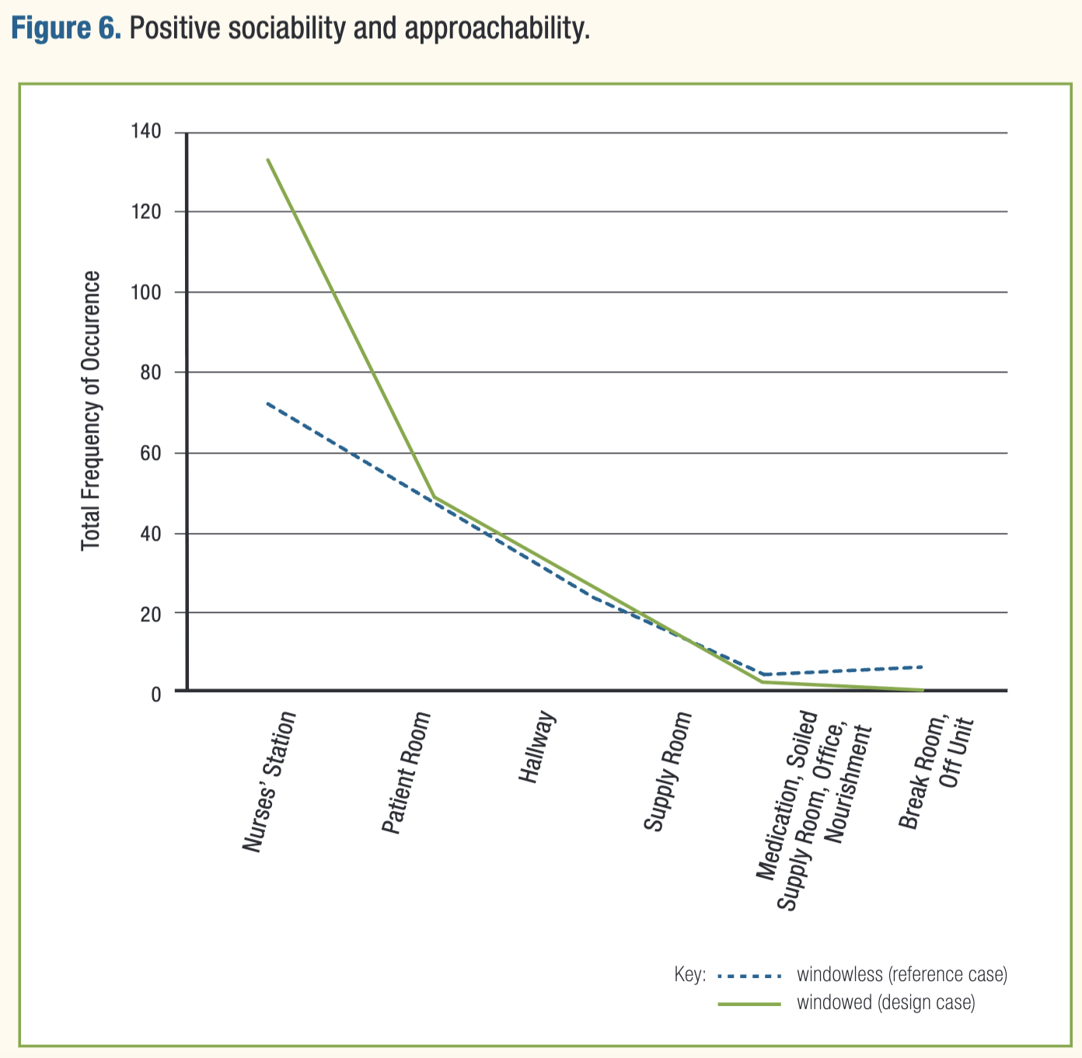

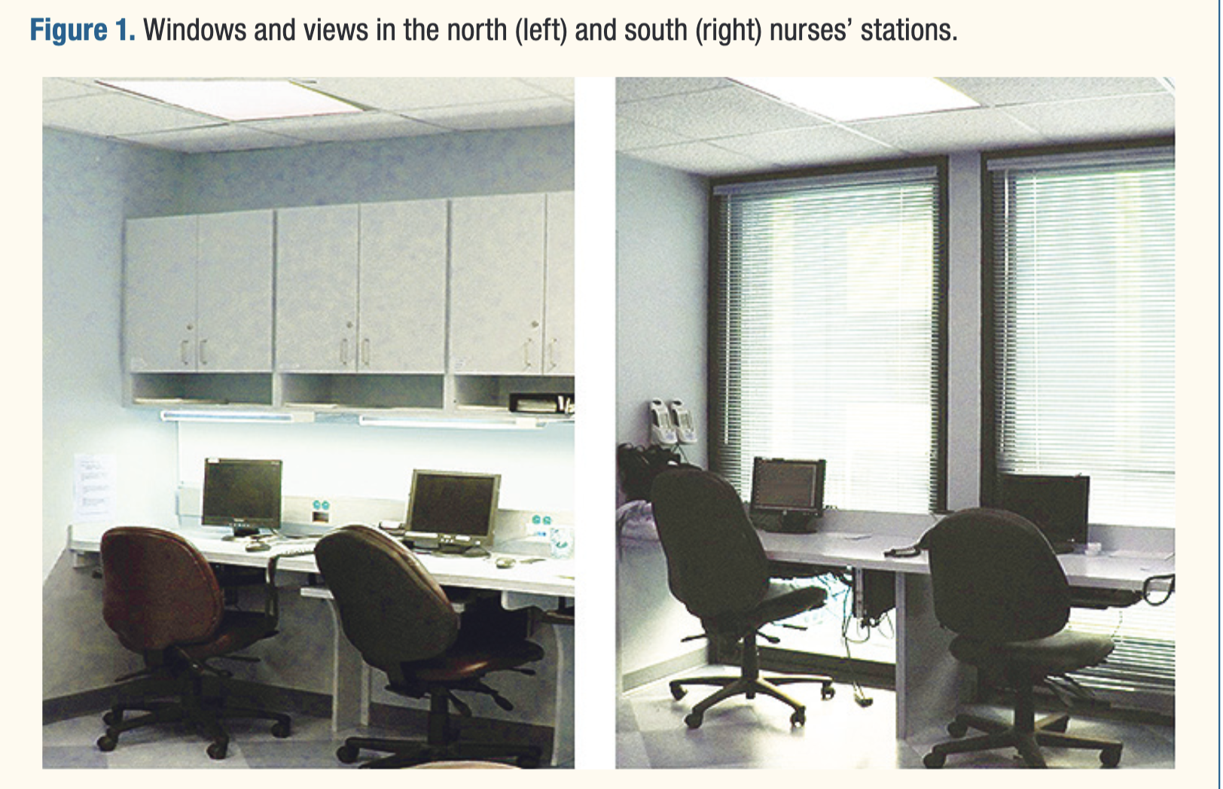
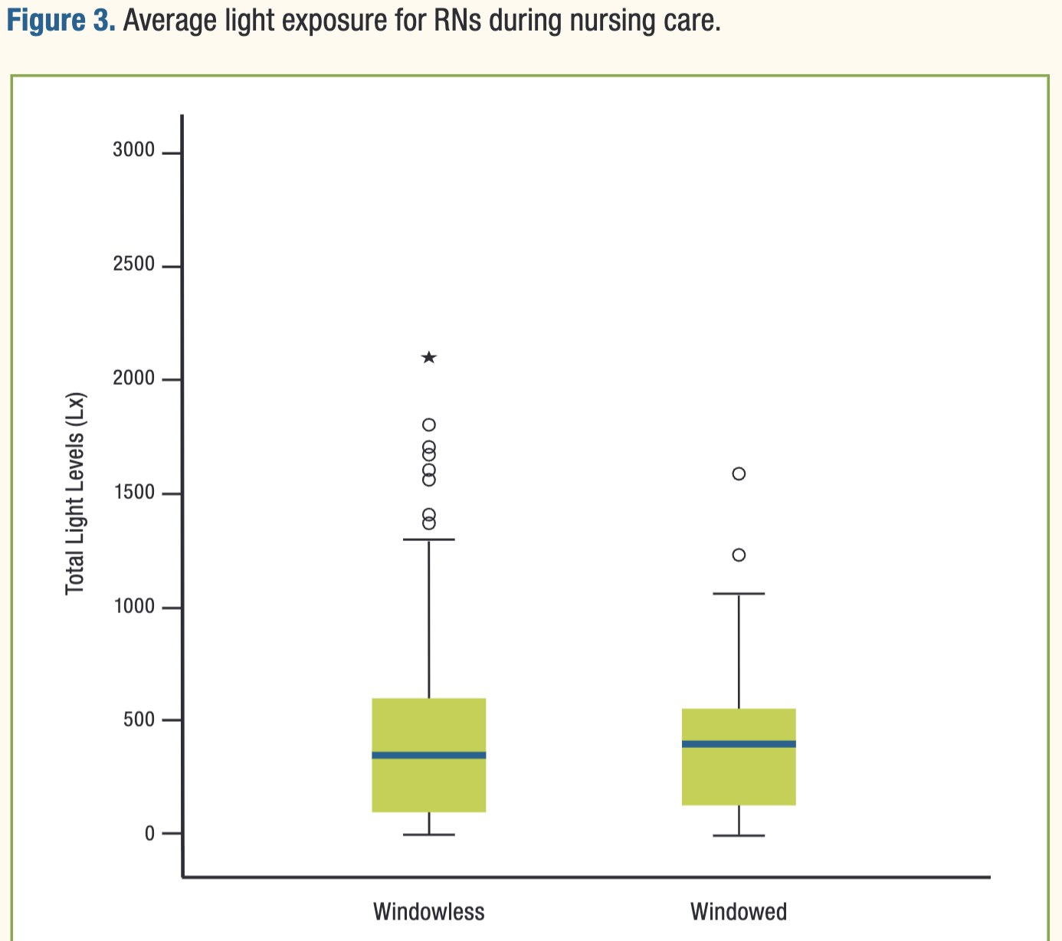
Improves morale for nurses too…
Same light levels…
Blood pressure decreased,
Body temperature increased.
Communication and laughter both increased
Subsidiary behaviour indicators of sleepiness and deteriorated mood decreased…
Zadeh, R., Shepley, M., Williams, G., & Chung, S. (2014). The Impact of Windows and Daylight on Acute-Care Nurses' Physiological, Psychological, and Behavioral Health. Herd, 7, 35-61. https://doi.org/10.1177/193758671400700405

Slide 32
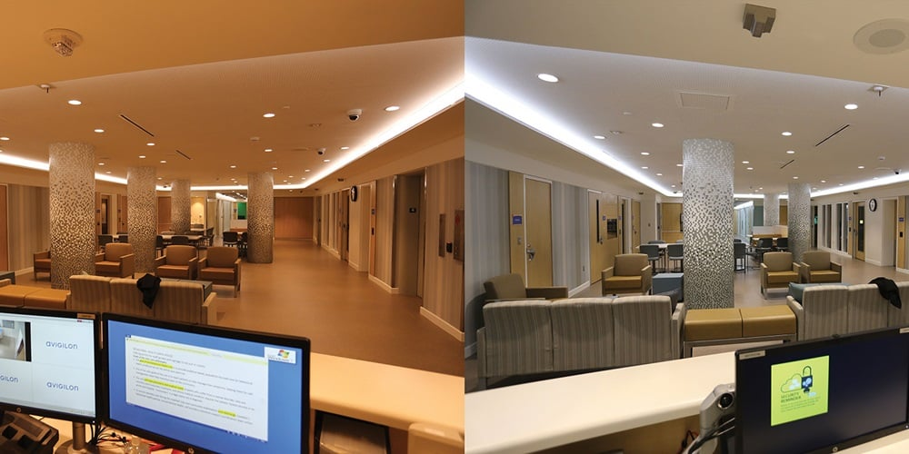
Could artificial lighting help?
Age of Light Innovations 2023

Slide 33


Slide 34
‘Sky blue’
Mure L. S. (2021). Intrinsically Photosensitive Retinal Ganglion Cells of the Human Retina. Frontiers in neurology, 12, 636330. https://doi.org/10.3389/fneur.2021.636330
Notes:
We also know they have a peak sensitivity to around 480 nanometers - although note overlapping sensitivity curves for rods, cones and ipRGCS- not an ‘on-off’ switch. We’ll talk more about how we know that in a minute -

Slide 35
https://www.sunlightinside.com/light-and-health/natural-light-vs-artificial-light/

Slide 36

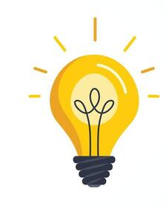




Slide 37

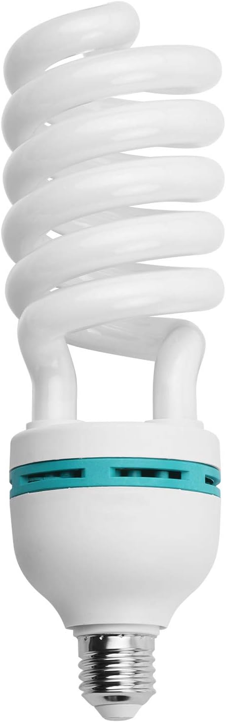
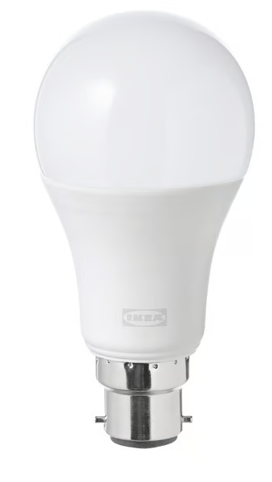




Slide 38
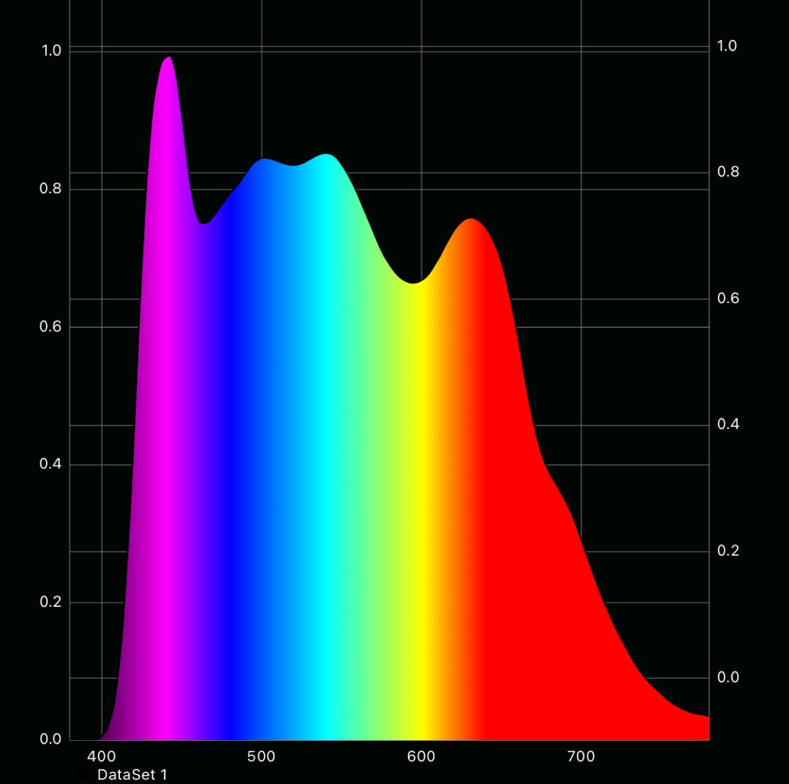

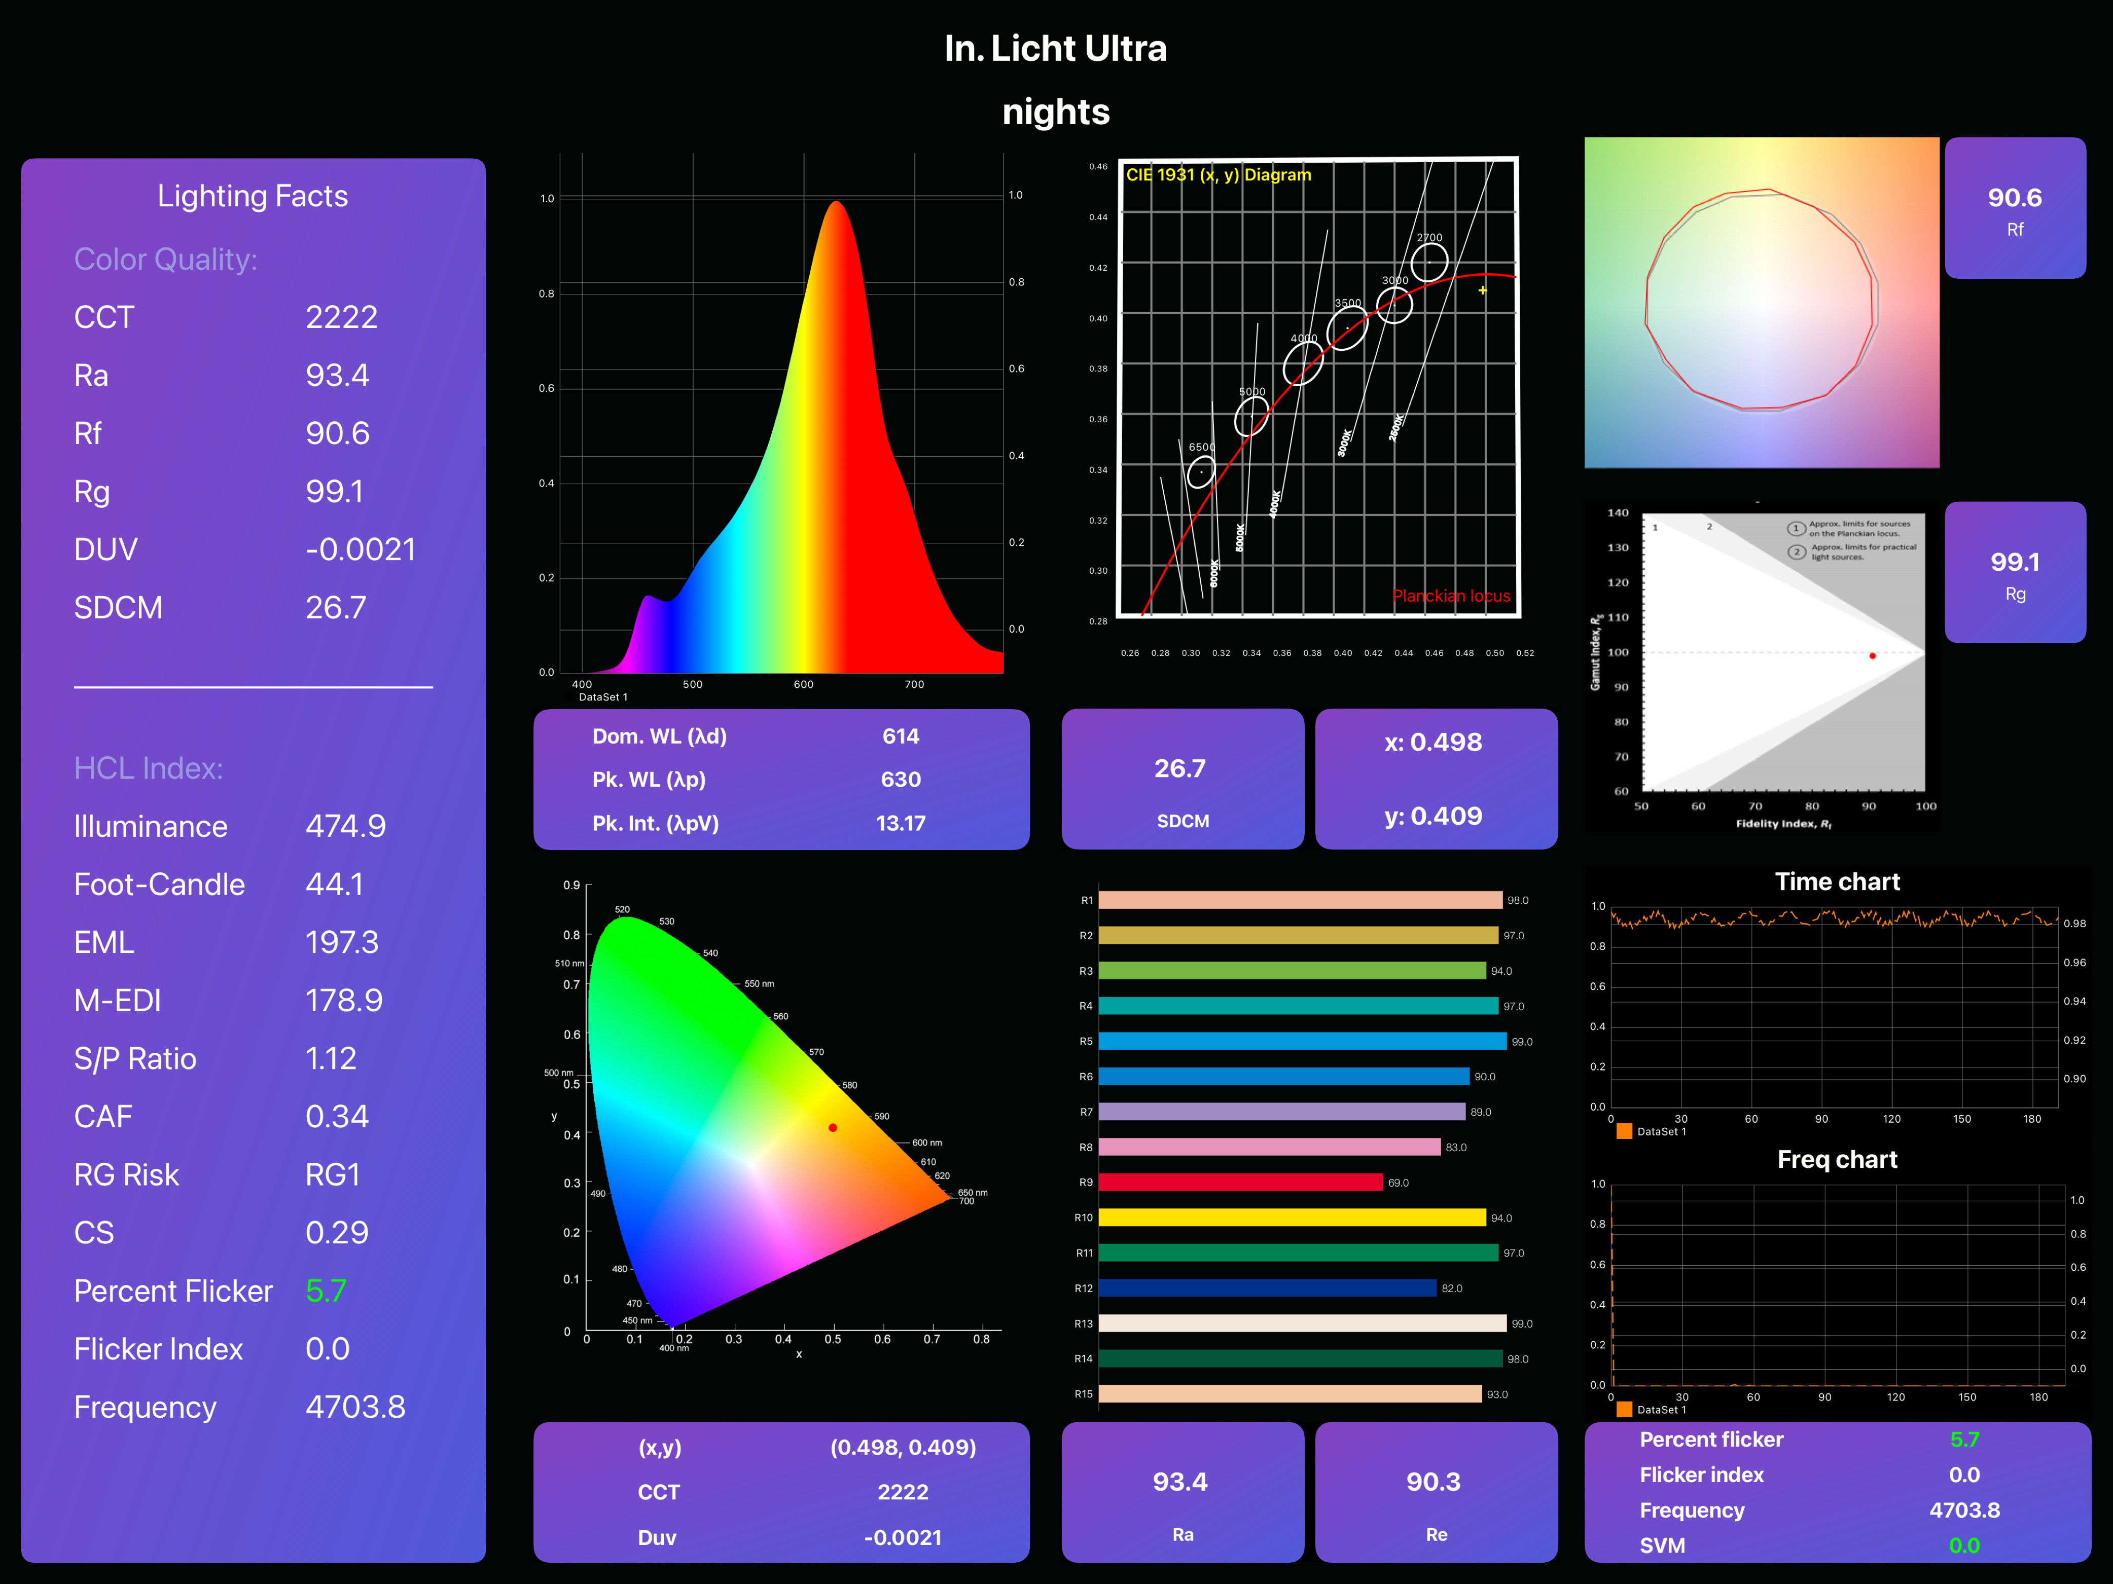
‘Full-spectrum’ LED
‘Cool’/focus setting
‘Warm’/night time setting

Slide 39
Tunable
Dynamic
Circadian
Notes:
It’s useful to think of lighting that changes from cool to warm in three broad levels or types
Tunable lighting - you can dial the colour temperature up or down
Dynamic - the colour temperature and intensity change automatically over time based on pre-established settings or cycles
Circadian - the colour temperature and intensity shift over the course of the day and into evening and are calibrated to deliver the recommended light levels.

Slide 40

As good as a cup of coffee (without the side-effects)
Notes:
Blue light is a powerful stimulus - a bit like a coffee… some studies that provide specific numbers-
40 lux blue light v 100 lux ‘white light’ - (40 lxTechlight® RGB, 3W, λmax = 470 nm) or a ‘white light ‘alternative (~100 lx) for 1 h.
In a test of executive function, where a distraction was included, caffeine exerted a negative effect on accuracy.
The ‘blue light only’ condition consistently outperformed caffeine when both congruent and incongruent distractions were presented.
The visual reactions in the absence of a decision or distraction were also enhanced in the blue light only condition
This effect was most prominent in the blue-eyed participants.
Exposure to bright light (7,000 lux at the eye) dynamically promoted cortical activity in networks involved in ongoing non-visual cognitive processes.
Beaven CM, Ekström J. A comparison of blue light and caffeine effects on cognitive function and alertness in humans. PLoS One. 2013;8(10):e76707. Published 2013 Oct 7. doi:10.1371/journal.pone.0076707
Gilles Vandewalle, Evelyne Balteau, Christophe Phillips, André Luxen, Derk-Jan Dijk, Pierre Maquet, Daytime Light Exposure Dynamically Enhances Brain Responses, Current Biology, Vol 16, Issue 16, P1616-1621, Aug 22, 2006, DOI:https://doi.org/10.1016/j.cub.2006.06.031

Slide 41



Bright light is as good as an antidepressant ;-)
“Light therapy and antidepressants were equally effective…
Light therapy combined with antidepressants was significantly better than antidepressants alone…”
BLT reduced the risk of SAD incidence by 36%
Geoffroy, P. A., Schroder, C. M., Reynaud, E., & Bourgin, P. (2019). Efficacy of light therapy versus antidepressant drugs, and of the combination versus monotherapy, in major depressive episodes: A systematic review and meta-analysis. Sleep Med Rev, 48, 101213. https://doi.org/10.1016/j.smrv.2019.101213
Maruani, J., & Geoffroy, P. A. (2019). Bright Light as a Personalized Precision Treatment of Mood Disorders [Review]. Frontiers in Psychiatry, 10. https://doi.org/10.3389/fpsyt.2019.00085

Slide 42
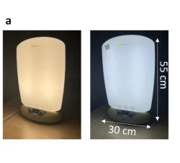
Blue-enriched light (‘SAD’) lamps work…
Longer duration of morning blue-enriched light…
significantly improved rest-activity rhythm stability and decreased sleep fragmentation….
Evening light exposure, however,
increased sleep latency and lowered sleep efficiency
Barroggi Constantino, D., Lederle, K. A., Middleton, B., Revell, V. L., Sletten, T. L., Williams, P., Skene, D. J., & van der Veen, D. R. (2025). The bright and dark side of blue-enriched light on sleep and activity in older adults. GeroScience. https://doi.org/10.1007/s11357-025-01506-y

Slide 43
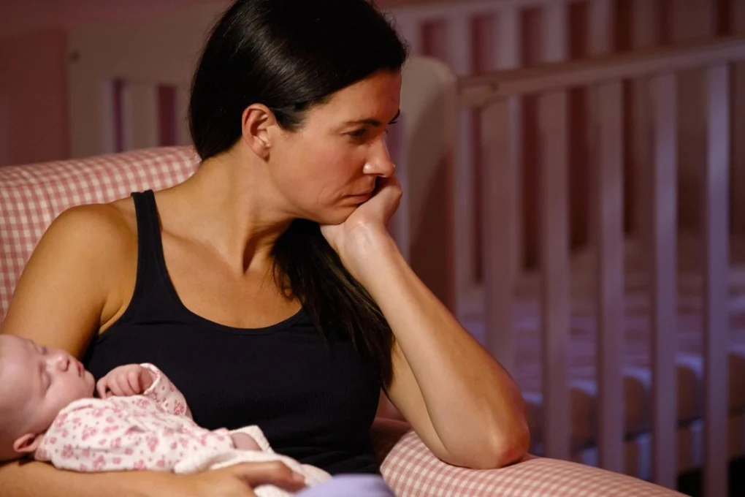
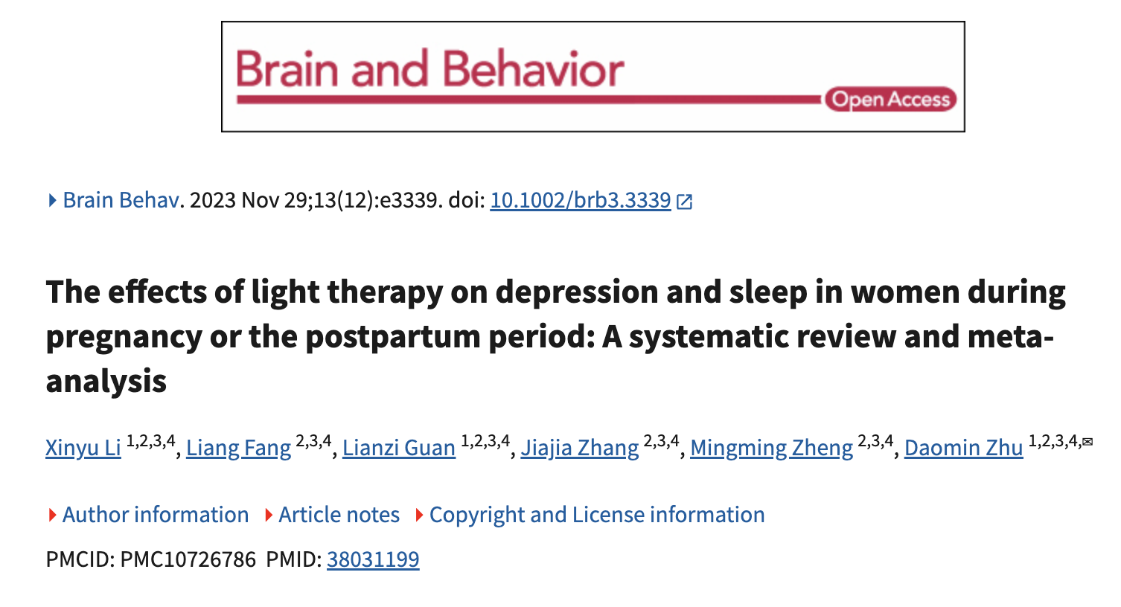
Post-natal depression
This meta‐analysis shows that
‘light therapy is effective for depression and sleep in women during pregnancy and the postpartum period.’
In addition, this review showed that there were no serious side effects between the light therapy and placebo groups.
Li, X., Fang, L., Guan, L., Zhang, J., Zheng, M., & Zhu, D. (2023). The effects of light therapy on depression and sleep in women during pregnancy or the postpartum period: A systematic review and meta-analysis. Brain Behav, 13(12), e3339. https://doi.org/10.1002/brb3.3339

Slide 44

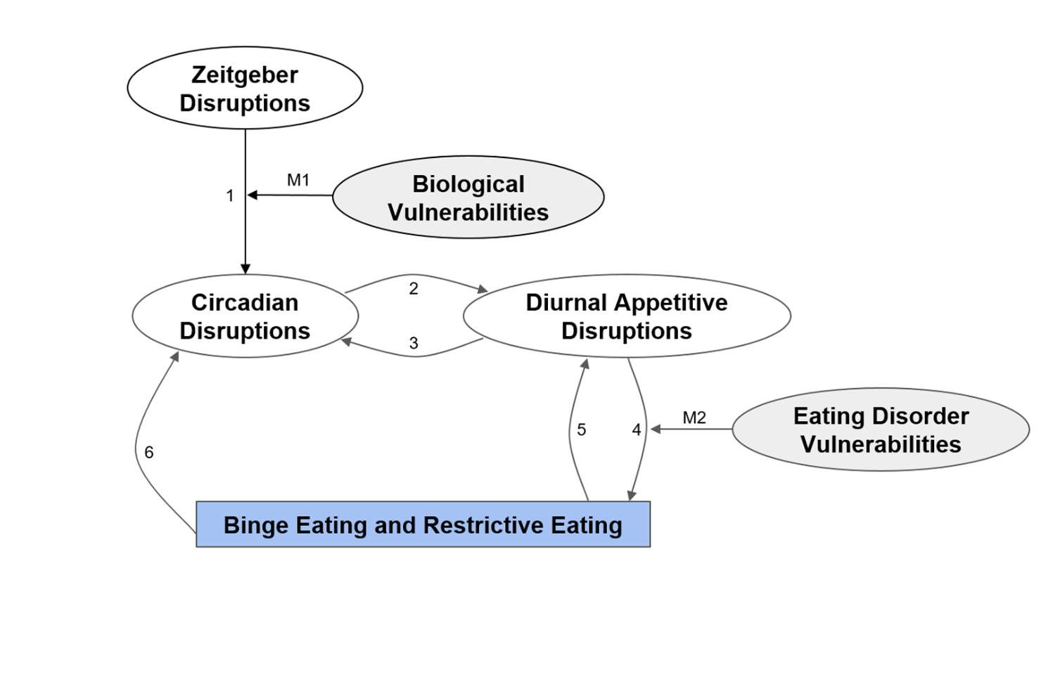
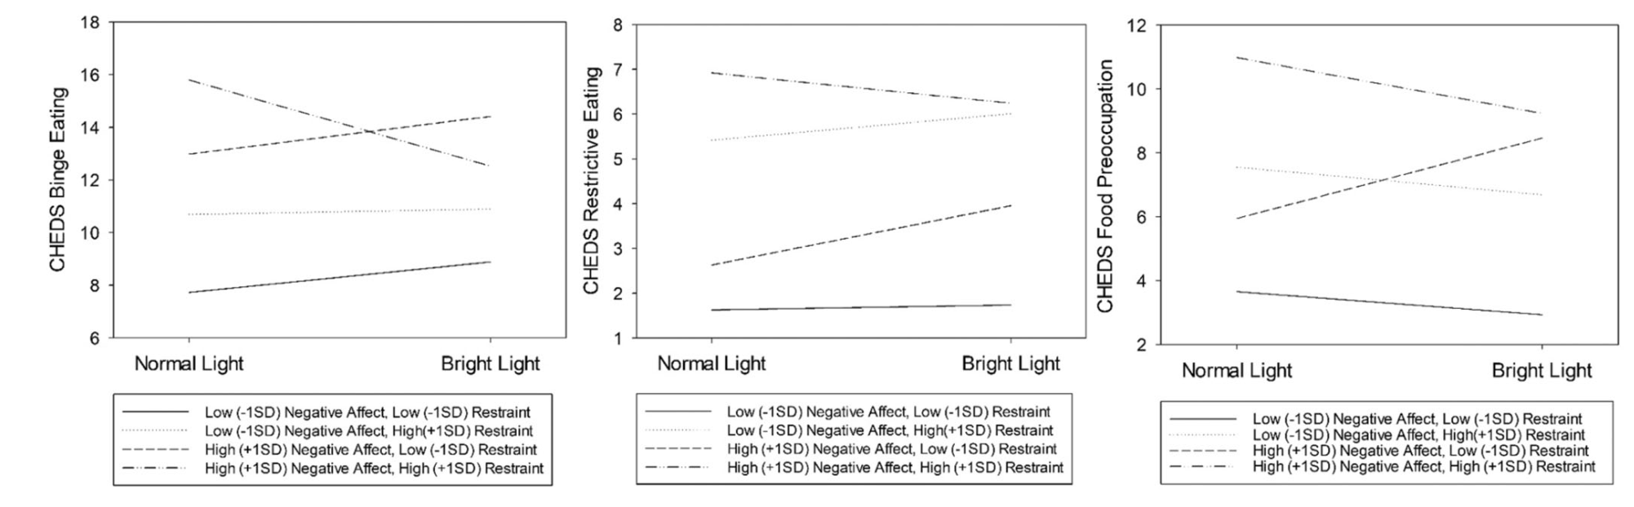
Eating disorders -
a circadian component?
Kambanis, P. E., Bottera, A. R., & De Young, K. P. (2023). Responses to bright light exposure in individuals with binge-spectrum eating disorders characterized by high dietary restraint and negative affect. Int J Eat Disord, 56(12), 2250-2259. https://doi.org/10.1002/eat.24054

Slide 45
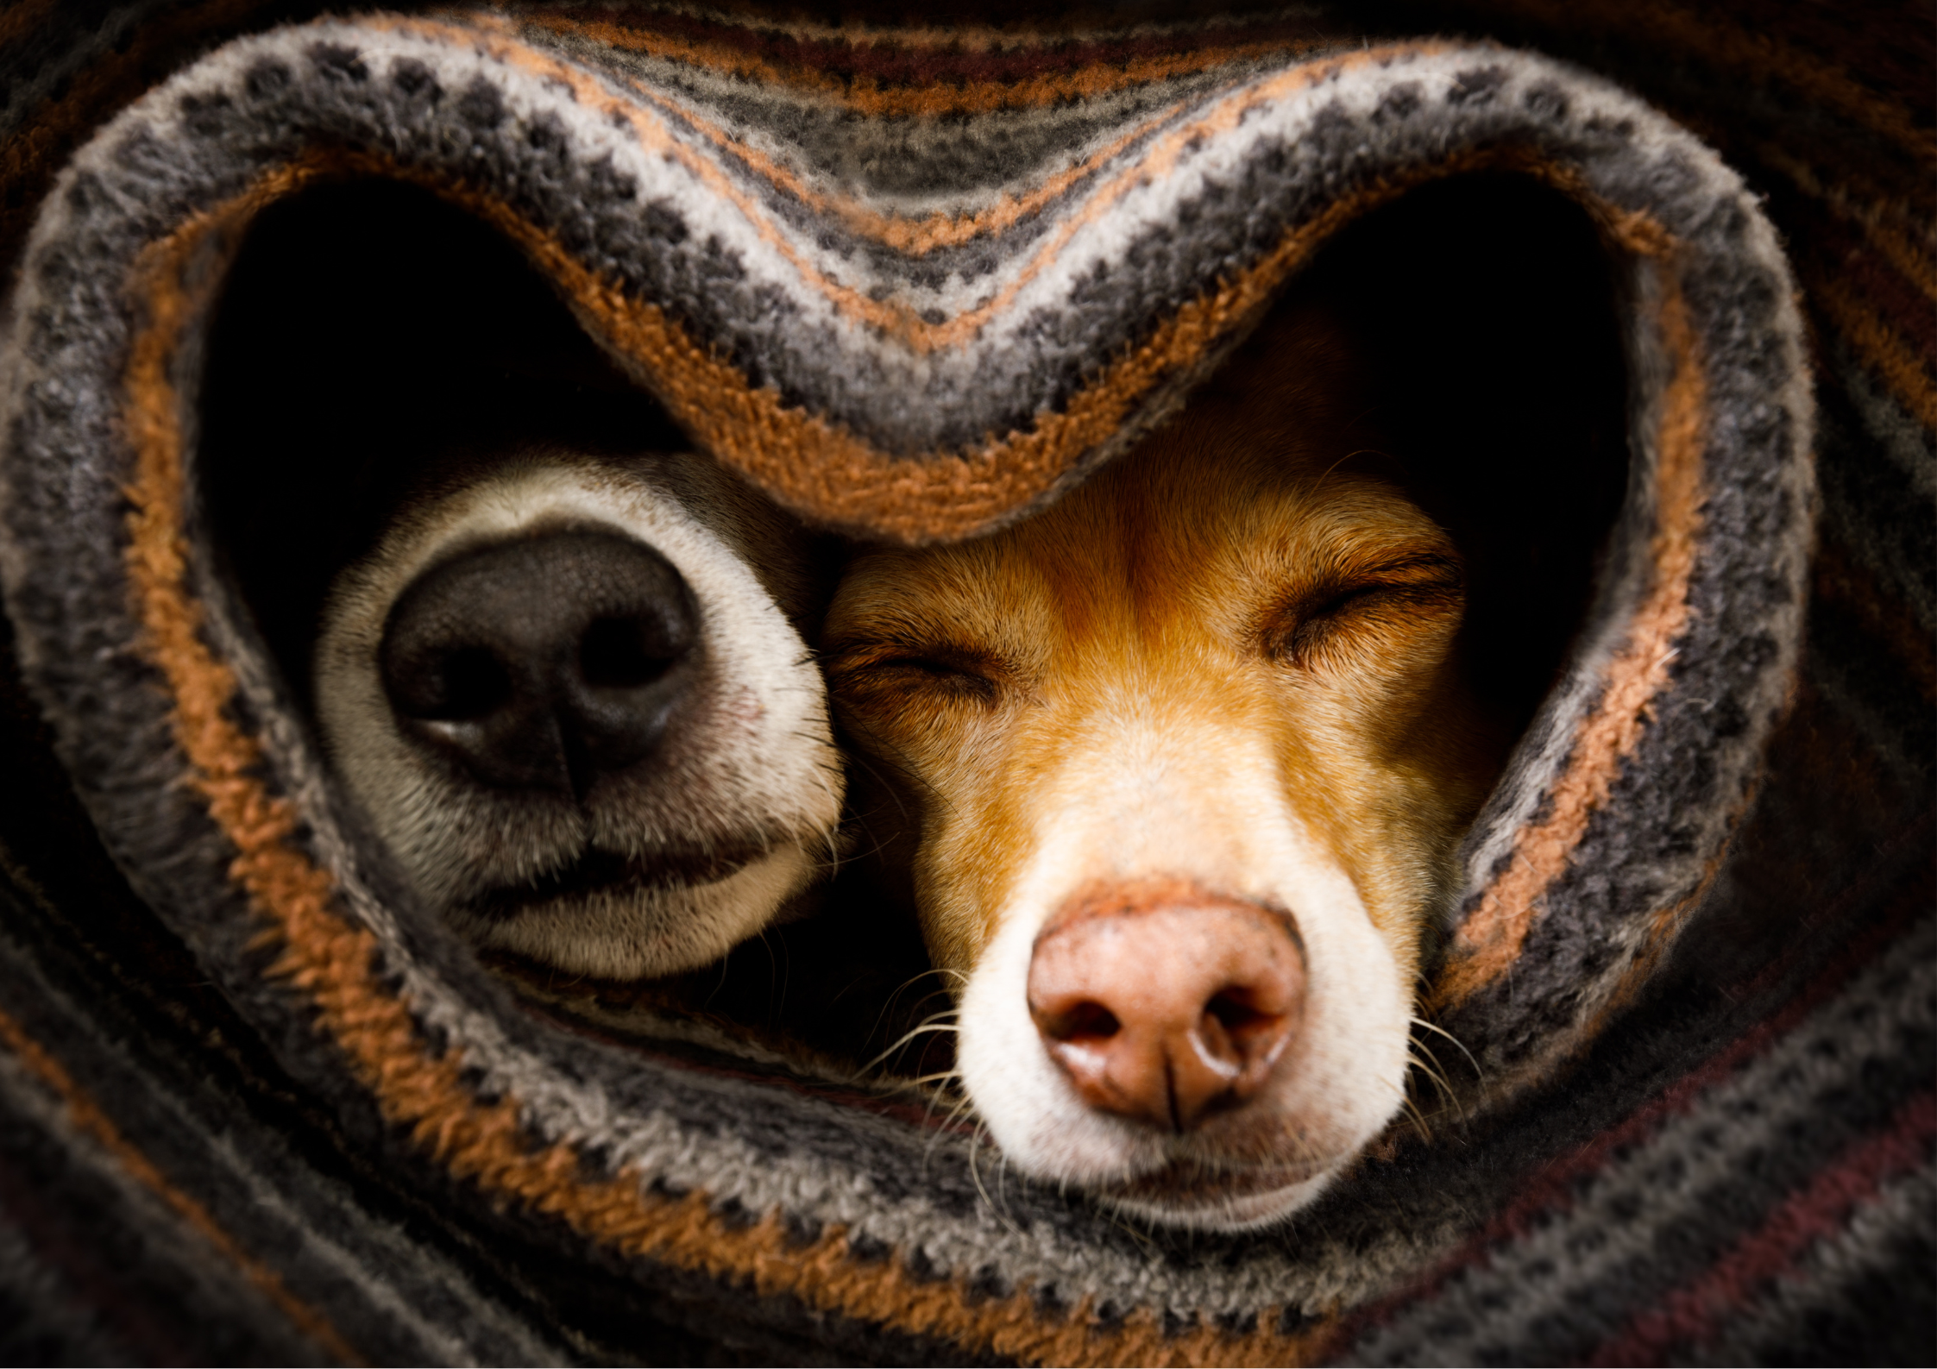
Age of Light Innovations 2023
The campfire effect
(creativity, collaboration and conflict resolution)
Notes:
That doesn’t mean we only respond to blue -
Warm light also has a powerful effect - including the ‘hue-heat’ effect - you can believe a space is up to two degrees warmer just by altering the lights!

Slide 46
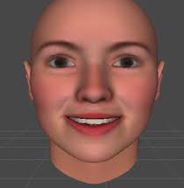
See them in a warmer light…
Lower CCT…
significantly decreased negative response bias in the face judgment task,
with labeling ambiguous faces less fearful under 2700 K vs. 6500 K condition.
Moreover, participants responded slightly faster for emotional pictures under 6500 K vs. 2700 K condition…
Li, Y., Ru, T., Chen, Q., Qian, L., Luo, X., & Zhou, G. (2021). Effects of illuminance and correlated color temperature of indoor light on emotion perception. Scientific Reports, 11(1), 14351. https://doi.org/10.1038/s41598-021-93523-y

Slide 47
Destress or activate…
Kuijsters A, Redi J, de Ruyter B, Heynderickx I. Lighting to Make You Feel Better: Improving the Mood of Elderly People with Affective Ambiences. PLoS One. 2015 Jul 20;10(7):e0132732. doi: 10.1371/journal.pone.0132732. PMID: 26192281; PMCID: PMC4507869.
Notes:
Kuijsters A, Redi J, de Ruyter B, Heynderickx I. Lighting to Make You Feel Better: Improving the Mood of Elderly People with Affective Ambiences. PLoS One. 2015 Jul 20;10(7):e0132732. doi: 10.1371/journal.pone.0132732. PMID: 26192281; PMCID: PMC4507869.

Slide 48


Willingness to seek help in primary school children…
…the visual warmth of the counseling room
had a significant effect on the direct prediction of willingness to seek help…
Huang, X., Bei, L., Yinyin, W., Xin, L., & Miao, C. (2023). Effect of visual warmness of counseling room on primary school students' willingness to psychological help‐seeking: The role of intimacy and cognitive style. Psychology in the Schools, 60, 5004-5024. https://doi.org/10.1002/pits.23040

Slide 49


Task performance was not significantly affected by having and exercising control, but having and exercising control may reduce mental demands, and increase self-perceived performance, pleasure and alertness.
Luo, W., Kramer, R., Kompier, M., Smolders, K., de Kort, Y., & van Marken Lichtenbelt, W. (2023). Personal control of correlated color temperature of light: Effects on thermal comfort, visual comfort, and cognitive performance. Building and Environment, 238, 110380. https://doi.org/https://doi.org/10.1016/j.buildenv.2023.110380

Slide 50


Slide 51
Tunable
Dynamic
Circadian
Notes:
It’s useful to think of lighting that changes from cool to warm in three broad levels or types
Tunable lighting - you can dial the colour temperature up or down
Dynamic - the colour temperature and intensity change automatically over time based on pre-established settings or cycles
Circadian - the colour temperature and intensity shift over the course of the day and into evening and are calibrated to deliver the recommended light levels.

Slide 52


Slide 53
Current benchmark to set the body clock
Molina-Montes, E., Rodríguez-Barranco, M., Ching-López, A., Artacho, R., Huerta, J. M., Amiano, P., Lasheras, C., Moreno-Iribas, C., Jimenez-Zabala, A., Chirlaque, M.-D., Barricarte, A., Luján-Barroso, L., Agudo, A., Jakszyn, P., Quirós, J. R., & Sánchez, M. J. (2022). Circadian clock gene variants and their link with chronotype, chrononutrition, sleeping patterns and obesity in the European prospective investigation into cancer and nutrition (EPIC) study. Clinical Nutrition, 41(9), 1977-1990. https://doi.org/https://doi.org/10.1016/j.clnu.2022.07.027

Slide 54

Evening light in average home disrupts circadian cycle for the average person
Cain, S. W., McGlashan, E. M., Vidafar, P., Mustafovska, J., Curran, S. P. N., Wang, X., Mohamed, A., Kalavally, V., & Phillips, A. J. K. (2020). Evening home lighting adversely impacts the circadian system and sleep. Scientific Reports, 10(1), 19110. https://doi.org/10.1038/s41598-020-75622-4
Notes:
That may be because light levels in the average home are bright enough to keep us awake

Slide 55
One night is enough …
100 lux v 3 lux at night
+ nighttime heart rate
- heart rate variability
+ next-morning insulin resistance
Ivy C. Mason Daniela Grimaldi Kathryn J. Reid, Phyllis C. Zee, Light exposure during sleep impairs cardiometabolic function PNAS, Vol. 119 | No. 12, March 14, 2022 e2113290119.https://doi.org/10.1073/pnas.211329011
Notes:
Even moderate moderate levels (100 lx) light during sleep - increases nighttime heart rate, decreases heart rate variability, and increases next-morning insulin resistance compared to a dimly lit (<3 lx) environment.

Slide 56

Pre- v post-adolescents
x2 more sensitive to light after dark
Increased sensitivity to spectrum, too
Crowley SJ, Cain SW, Burns AC, Acebo C, Carskadon MA. Increased Sensitivity of the Circadian System to Light in Early/Mid-Puberty. J Clin Endocrinol Metab. 2015 Nov;100(11):4067-73. doi: 10.1210/jc.2015-2775. Epub 2015 Aug 24. PMID: 26301944; PMCID: PMC4702443.
Eto, T., & Higuchi, S. (2023). Review on age-related differences in non-visual effects of light: melatonin suppression, circadian phase shift and pupillary light reflex in children to older adults. Journal of PHYSIOLOGICAL ANTHROPOLOGY, 42. https://doi.org/10.1186/s40101-023-00328-1
Notes:
Even within children, age makes a difference
Not only are pre-teens acutely sensitive to light after dark.
Even with the same melanopic lux, sensitivity to cool CCT is greater among children compared to adults.

Slide 57


Sleep and teens…
Lower intensity overall
Later sleep onset
Later next-day sleep offset
Time of last exposure
Later sleep onset
Shorter objective sleep
Higher average morning light
Earlier sleep onset
Earlier next-day wake-time
Gasperetti CE, Dolsen EA, Harvey AG. The influence of intensity and timing of daily light exposure on subjective and objective sleep in adolescents with an evening circadian preference. Sleep Med. 2021 Mar;79:166-174. doi: 10.1016/j.sleep.2020.11.014. Epub 2020 Nov 16. PMID: 33262011; PMCID: PMC7925365.
Notes:
Interestingly, also impacts sleep in spaces where people are active during the day.
We saw extreme sensitivity to light at night in teens - enhanced lighting during the day can help -
Lower average light intensity during the day and evening >10 lux impacts quality and quantity of sleep: harder to fall asleep, less sleep, worse quality sleep, circadian intervention (bright light during the morning before 9am) improves sleep.
Brighter morning light has positive effects not only that evening but the following evening too.

Slide 58

Inpatients with major depressive disorder
Dynamic lighting:
woke up earlier
slept x2 longer
higher sleep efficiency (+ 2.4%)
shorter periods of nighttime awakenings
Canazei, M., Weninger, J., Pohl, W., Marksteiner, J., & Weiss, E. (2022). Effects of dynamic bedroom lighting on measures of sleep and circadian rest-activity rhythm in inpatients with major depressive disorder. Scientific Reports, 12, 6137. https://doi.org/10.1038/s41598-022-10161-8

Slide 59




Schizophrenia
Improving sleep and affect
Circadian lighting significantly improved BPRS scores with affectivity scores also showing significant enhancements postintervention
Skeldon, A. C., Dijk, D.-J., Meyer, N., & Wulff, K. (2021). Extracting Circadian and Sleep Parameters from Longitudinal Data in Schizophrenia for the Design of Pragmatic Light Interventions. Schizophrenia Bulletin, 48(2), 447-456. https://doi.org/10.1093/schbul/sbab124

Slide 60
Dementia
+ pleasure and alertness
  5% cognitive decline
  19% depressive symptoms
  53% relative decline in functional ability
Münch Mirjam *, Schmieder Michael, Bieler Katharina, Goldbach Rolf, Fuhrmann Timo , Zumstein Naomi , Vonmoos Petra, Scartezzini Jean-Louis , Wirz-Justice Anna and Cajochen Christian , Bright Light Delights: Effects of Daily Light Exposure on Emotions, Restactivity Cycles, Sleep and Melatonin Secretion in Severely Demented Patients, Current Alzheimer Research 2017; 14(10) . https://dx.doi.org/10.2174/1567205014666170523092858
Riemersma-van der Lek RF, Swaab DF, Twisk J, Hol EM, Hoogendijk WJG, Van Someren EJW. Effect of Bright Light and Melatonin on Cognitive and Noncognitive Function in Elderly Residents of Group Care Facilities: A Randomized Controlled Trial. JAMA. 2008;299(22):2642–2655. doi:10.1001/jama.299.22.2642
Notes:
The parts of the brain that regulate the sleep-wake cycle are smaller and signalling pathways are weaker, As a result, lighting that supports their sleep-wake cycle is particularly important.
One study that used biodynamic lighting (shifting from bright cool to dim warm over the course of the day found
average frequency of night-time bed wandering significantly decreased from 11 to 5 times
The average frequency of daytime napping significantly decreased from 16 to 7 times
The average total night-time sleep significantly increased from 408 to 495 min
The average total time out of bed at night significantly decreased from 180 to 104 min (P = 0.006).
Another study showed that circadian lighting was more effective than melatonin alone for a range of health outcomes.
improved cognitive decline by 5% (and depressive symptoms by 19%
reduced the decline in functional abilities by a relative 53%
Melatonin alone decreased positive mood and increased withdrawn behavior, but improved sleep.
In those patients who received both bright light and melatonin, the negative effects of the hormone were suppressed and the positive effects were more pronounced.
Immediate effect of ‘Bright Light Therapy (10,000 lux for 30 minutes) on people with severe dementia. This study asked carers to rate the patients state of mind using particular key words
significant decrease in Tearful/sad and Talked spontaneously rating
significant increase in Enjoying self, active or alert, and Relaxed, content or sleeping appropriately rating
physiological parameters changed positively from before to after the sessions
Ellen van Lieshout-van Dal, Liselore Snaphaan, Inge Bongers, Biodynamic lighting effects on the sleep pattern of people with dementia,, Volume 150, 2019, Pages 245-253, ISSN 0360-1323, https://doi.org/10.1016/j.buildenv.2019.01.010. (https://www.sciencedirect.com/science/article/pii/S0360132319300101)
Cibeira, N.; Maseda, A.; Lorenzo-López, L.; González-Abraldes, I.; López-López, R.; Rodríguez-Villamil, J.L.; Millán-Calenti, J.C. Bright Light Therapy in Older Adults with Moderate to Very Severe Dementia: Immediate Effects on Behavior, Mood, and Physiological Parameters. Healthcare 2021, 9, 1065. https://doi.org/10.3390/healthcare9081065
Sidani, S., Fox, M. T., Butler, J. I., & Maimets, I.-K. (2022). Development of a multi-component intervention to promote sleep in older persons with dementia transitioning from hospital to home. International Journal of Older People Nursing, 00, e12463. https://doi.org/10.1111/opn.12463
Bright light improves cognitive and noncognitive function in patients with dementia. Nat Rev Neurol 4, 468 (2008). https://doi.org/10.1038/ncpneuro0875

Slide 61

Control room shift
Dynamic lighting
Significant increase in
- Peak melatonin concentration
- Cognitive performance after night work
Stable
- Physiological and behavioural rhythms
- Mood status
Nie, J., Zhou, T., Chen, Z. et al. The effects of dynamic daylight-like light on the rhythm, cognition, and mood of irregular shift workers in closed environment. Sci Rep 11, 13059 (2021). https://doi.org/10.1038/s41598-021-92438-y
Notes:
Lighting that reflects day-night cycle even supports those with chronic disruption to body clock.
Note additional measures including cognitive performance and stability of mood and other rhythms, indicating entrainment.

Slide 62


Dynamic lighting in offices
Time-of-day and experimental-day dependent benefits of the Dynamic Light vs. Static Light pattern on
daytime vitality, sleepiness, state self-control, mood, performance on a sustained attention task and subsequent subjective sleep quality….
Kompier, M. E., Smolders, K. C. H. J., Kramer, R. P., van Marken Lichtenbelt, W. D., & de Kort, Y. A. W. (2022). Contrasting dynamic light scenarios in an operational office: Effects on visual experience, alertness, cognitive performance, and sleep. Building and Environment, 212, 108844. https://doi.org/https://doi.org/10.1016/j.buildenv.2022.108844
Ru, T., Kompier, M. E., Chen, Q., Zhou, G., & Smolders, K. C. H. J. (2023). Temporal tuning of illuminance and spectrum: Effect of a full-day dynamic lighting pattern on well-being, performance and sleep in simulated office environment. Building and Environment, 228, 109842. https://doi.org/https://doi.org/10.1016/j.buildenv.2022.109842

Slide 63
Does lighting really need to look like this…,?

Slide 64



Slide 65


The perfect time to upgrade the lights!
Digitization
Smart lighting control
LEDification
Insight, IoT and
user behavior
Comfort and well-being
Energy and cost savings
Customer
benefits
50%
Savings
80%
Savings
80+%
Savings
Notes:
Sustainability is a obviously a very important topic around the world these days.
If we talk about lighting and sustainability, we should not be having that conversation without the inclusion of lighting controls. As this slide shows, upgrading a lighting system to LED can generate 50% energy savings, however add controls, or better yet, smart lighting controls, and energy savings of over 80% are a probability not a possibility.

Slide 66


Thank you!

Slide 67



On-screen self-image
Mosalanejad, L., Karimian, Z., Ayaz, R., Maghsodzadeh, S., & Sefidfard, M. (2024). Zoom dysmorphia in medical students: the role of dysmorphic concern and self-efficacy in online environments amidst COVID-19 pandemic. BMC Medical Education, 24(1), 1330. https://doi.org/10.1186/s12909-024-06300-6

